Slide 1

Wireless Networking
Ambuj Varshney
Assistant Professor, National University of Singapore
Wireless, Embedded Intelligence, Sensing, and Emerging Technologies Group
ambujv@nus.edu.sg
Notes:
++ Thank you for inviting me to give this talk
++ In this talk, I will present a pathway that can enable us to make wireless embedded systems ubiquitous. I will describe my previous research efforts that tackle the critical challenges that limit the growth of wireless embedded systems. These are related to the growing energy asymmetry that exists between sensing, computation and communication blocks on these platforms.
++ Finally, I will conclude my talk by covering the research agenda that I would like to work on as a faculty member.

Slide 2
Lecture 1: Overview, Logistics
IoT and Wireless Preview and Basics
Notes:
++ Over the past few years, I have designed several backscatter and beyond backscatter systems that precisely overcome these critical challenges that have limited the widespread deployment of backscatter on IoT devices.
++ The research vision that I have pursued and would like to pursue as a faculty member is to enable a massive deployment of IoT devices by bridging the energy asymmetry between sensing, computation and communication blocks by designing novel platforms and communication mechanisms. I am going to describe some of my research contributions next.

Slide 3
Let's get to know the instructor!
Notes:
++ Over the past few years, I have designed several backscatter and beyond backscatter systems that precisely overcome these critical challenges that have limited the widespread deployment of backscatter on IoT devices.
++ The research vision that I have pursued and would like to pursue as a faculty member is to enable a massive deployment of IoT devices by bridging the energy asymmetry between sensing, computation and communication blocks by designing novel platforms and communication mechanisms. I am going to describe some of my research contributions next.

Slide 4
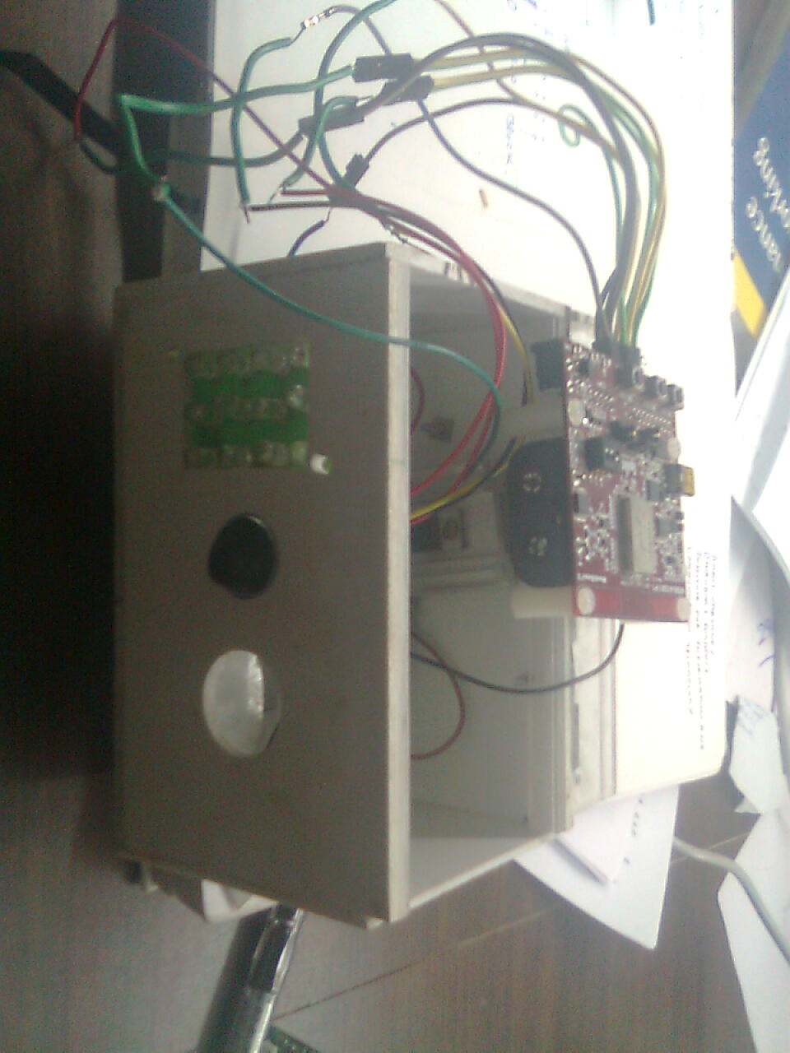
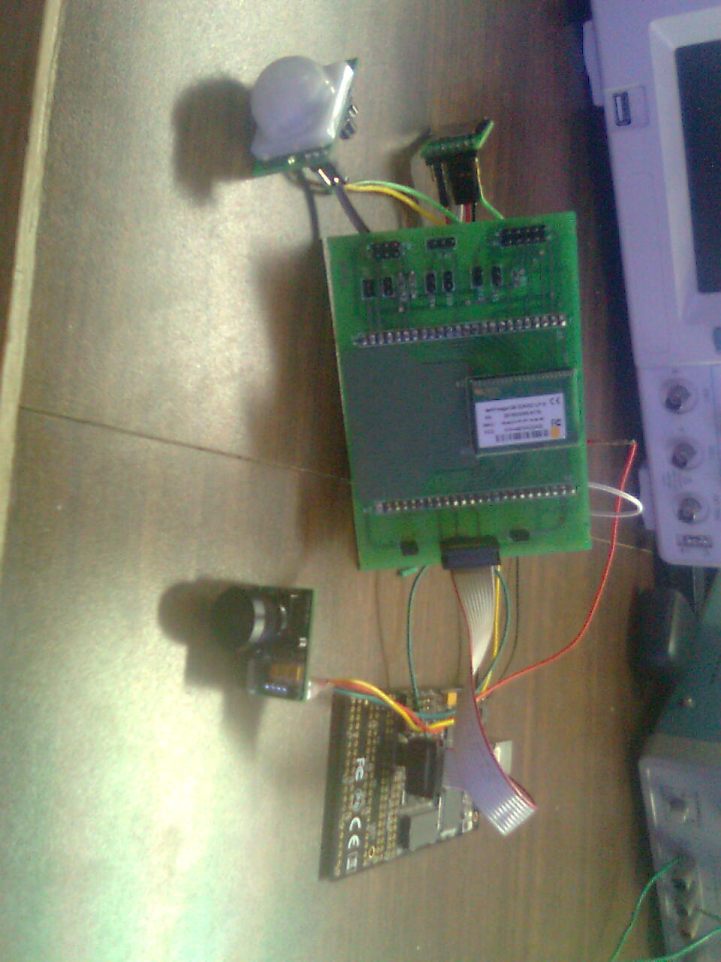
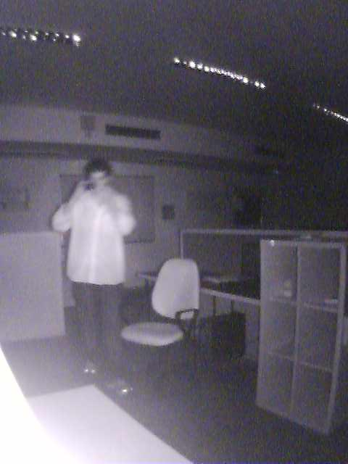
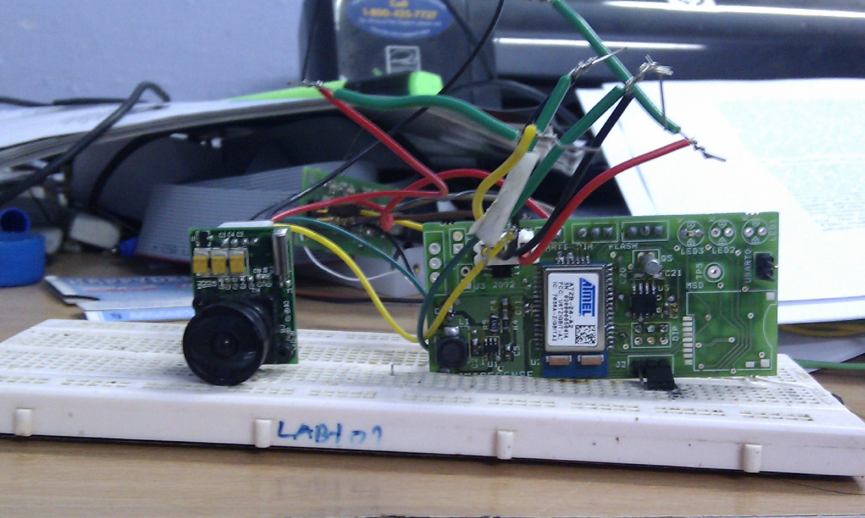
Get to know the instructor
Born in India, undergraduate studies in India (2007 - 2011)
Developed an interest in wireless embedded systems (2010)
Undergraduate project: Wireless camera that takes images of Tigers!
Version 0.1 (Meshnetics)
Version 0.2 (ZigBit)
Version 0.3 (RFA1, Contiki OS)
Image taken under infrared flash
Notes:
++ We may all have heard of the term Internet of Things. So how are these wireless embedded systems related to the Internet of Things: Today, IoT includes a broad class of devices, including powerful platforms such as smartphones. However, it also includes more resource-constrained devices and what we call Wireless Embedded Systems, and in fact, I consider it to be one of the essential parts of the IoT ecosystem.
++ These are platforms equipped with a radio transceiver, sensor, microcontroller, and some form of energy storage. These platforms also often form a network, and sensor network as it is called has been an active area of research for the past two decades.
++ The research community has also developed wireless embedded platforms which we may know about, and these include: CMUCAM, which is an image sensor platform developed at Carnegie Mellon University, or Permamote is long life sensor platform from the lab I am associated with at UC Berkeley or Lorea which is a long-range backscatter platform that I had developed as part of my doctoral dissertation at Uppsala University. All of these are an example of Wireless Embedded Systems.

Slide 5
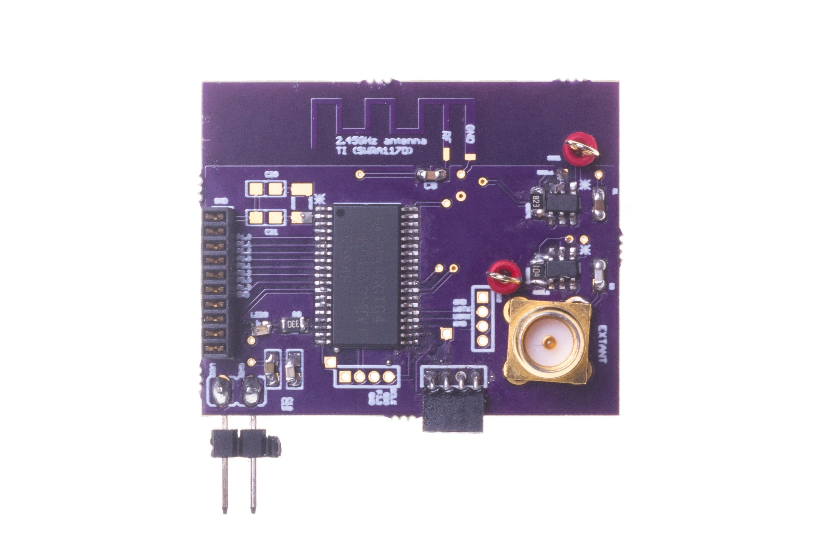
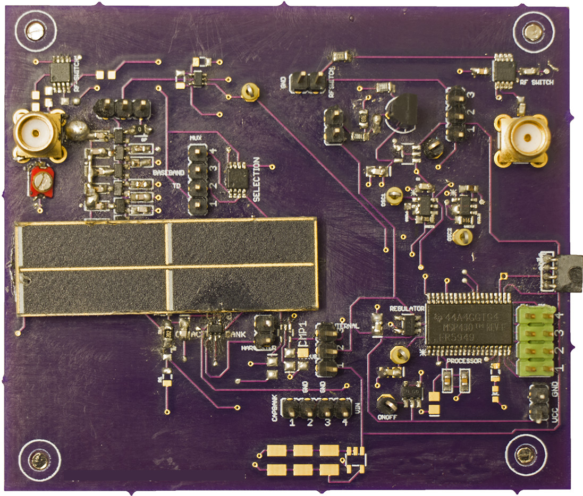
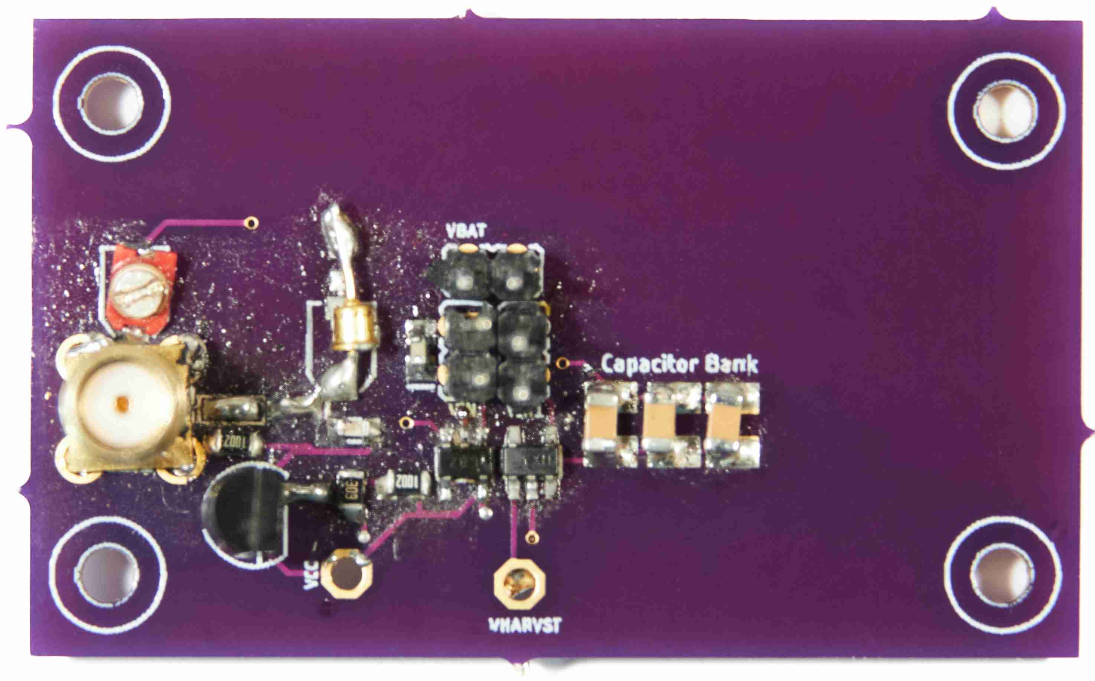
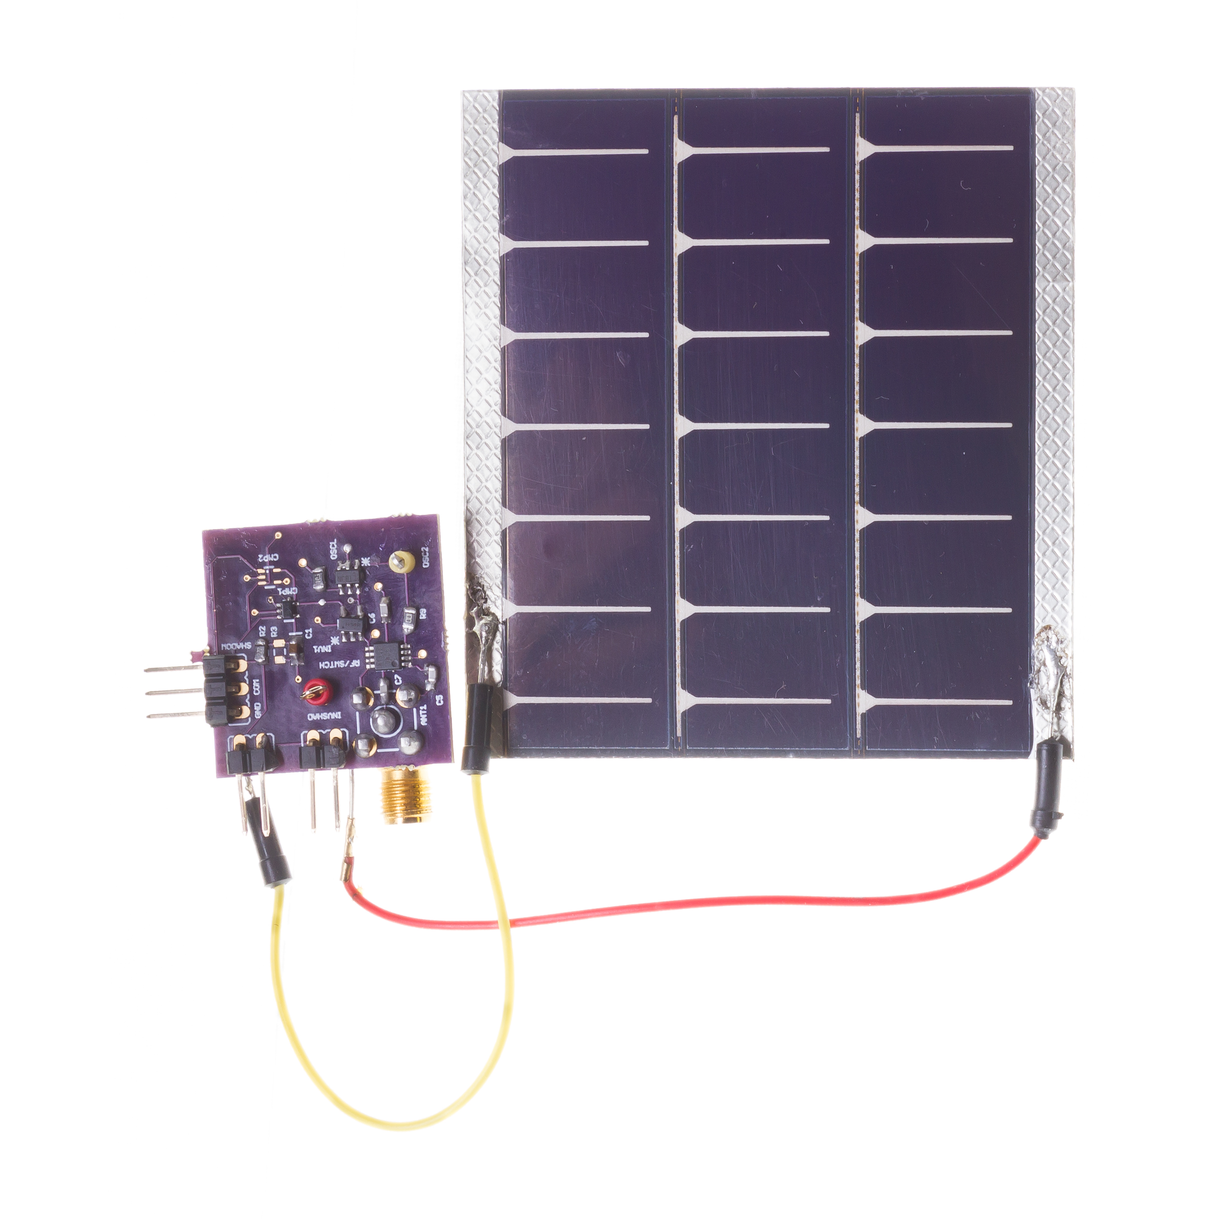
Get to know the instructor
Build real systems. Functional prototypes
Commonly, my work involves working at the intersection of computer science, electrical engineering and computer communication
[ACM SENSYS 2017]
[ACM MOBISYS 2020]
[ACM MOBICOM 2020]
[ACM VLCS 2017]
Notes:
++ We may all have heard of the term Internet of Things. So how are these wireless embedded systems related to the Internet of Things: Today, IoT includes a broad class of devices, including powerful platforms such as smartphones. However, it also includes more resource-constrained devices and what we call Wireless Embedded Systems, and in fact, I consider it to be one of the essential parts of the IoT ecosystem.
++ These are platforms equipped with a radio transceiver, sensor, microcontroller, and some form of energy storage. These platforms also often form a network, and sensor network as it is called has been an active area of research for the past two decades.
++ The research community has also developed wireless embedded platforms which we may know about, and these include: CMUCAM, which is an image sensor platform developed at Carnegie Mellon University, or Permamote is long life sensor platform from the lab I am associated with at UC Berkeley or Lorea which is a long-range backscatter platform that I had developed as part of my doctoral dissertation at Uppsala University. All of these are an example of Wireless Embedded Systems.

Slide 6

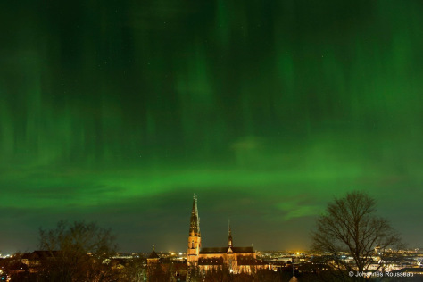
Get to know the instructor
Doctoral studies conducted in Sweden. PhD from Uppsala University
Dissertation: Enabling sustainable networked embedded systems
Notes:
++ We may all have heard of the term Internet of Things. So how are these wireless embedded systems related to the Internet of Things: Today, IoT includes a broad class of devices, including powerful platforms such as smartphones. However, it also includes more resource-constrained devices and what we call Wireless Embedded Systems, and in fact, I consider it to be one of the essential parts of the IoT ecosystem.
++ These are platforms equipped with a radio transceiver, sensor, microcontroller, and some form of energy storage. These platforms also often form a network, and sensor network as it is called has been an active area of research for the past two decades.
++ The research community has also developed wireless embedded platforms which we may know about, and these include: CMUCAM, which is an image sensor platform developed at Carnegie Mellon University, or Permamote is long life sensor platform from the lab I am associated with at UC Berkeley or Lorea which is a long-range backscatter platform that I had developed as part of my doctoral dissertation at Uppsala University. All of these are an example of Wireless Embedded Systems.

Slide 7
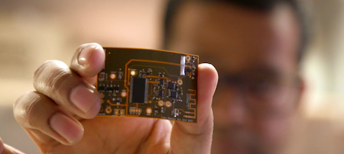


Get to know the instructor
Doctoral dissertation awarded 2019 ABB Research Award
Postdoctoral studies supported by 2019 ABB Award: UC Berkeley
Notes:
++ We may all have heard of the term Internet of Things. So how are these wireless embedded systems related to the Internet of Things: Today, IoT includes a broad class of devices, including powerful platforms such as smartphones. However, it also includes more resource-constrained devices and what we call Wireless Embedded Systems, and in fact, I consider it to be one of the essential parts of the IoT ecosystem.
++ These are platforms equipped with a radio transceiver, sensor, microcontroller, and some form of energy storage. These platforms also often form a network, and sensor network as it is called has been an active area of research for the past two decades.
++ The research community has also developed wireless embedded platforms which we may know about, and these include: CMUCAM, which is an image sensor platform developed at Carnegie Mellon University, or Permamote is long life sensor platform from the lab I am associated with at UC Berkeley or Lorea which is a long-range backscatter platform that I had developed as part of my doctoral dissertation at Uppsala University. All of these are an example of Wireless Embedded Systems.

Slide 8
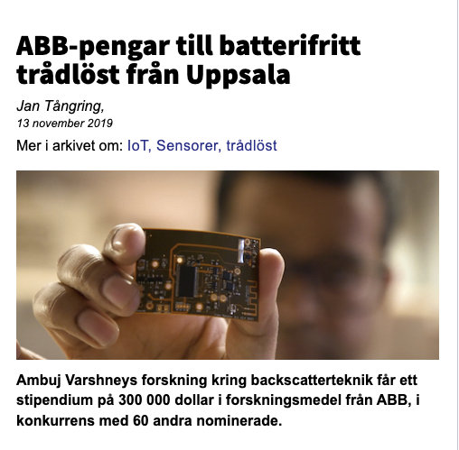
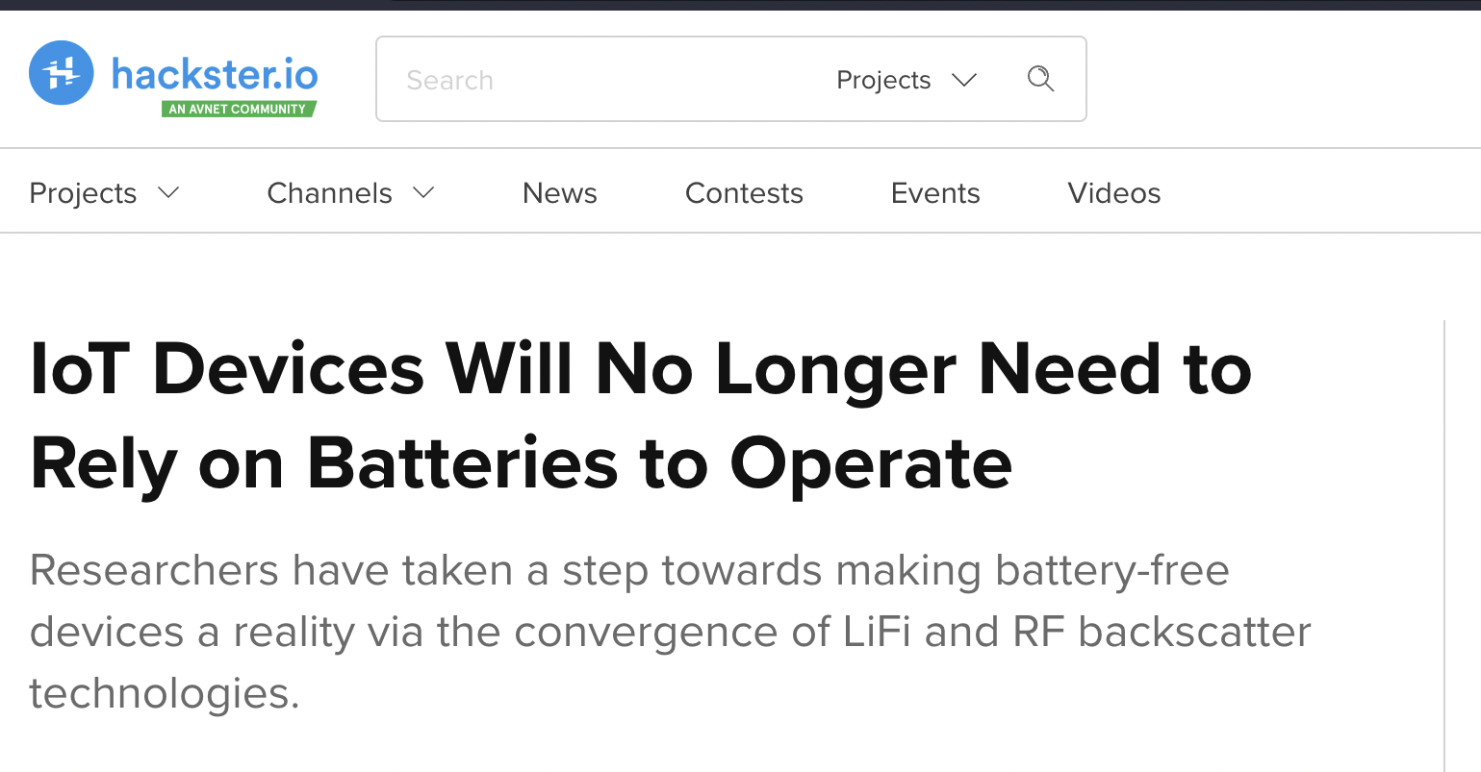

Wireless, Embedded Intelligence, Sensing and Emerging Technologies (WEISER) Group
Aim: World leading research in the area of wireless embedded systems
Regularly publish research findings in flagship venues of the area;
ACM MobiCom, MobiSys, SenSys, Ipsn, HotNets, Getmobile and others
Research findings and awards are regularly covered by major media outlets
Notes:
++ We may all have heard of the term Internet of Things. So how are these wireless embedded systems related to the Internet of Things: Today, IoT includes a broad class of devices, including powerful platforms such as smartphones. However, it also includes more resource-constrained devices and what we call Wireless Embedded Systems, and in fact, I consider it to be one of the essential parts of the IoT ecosystem.
++ These are platforms equipped with a radio transceiver, sensor, microcontroller, and some form of energy storage. These platforms also often form a network, and sensor network as it is called has been an active area of research for the past two decades.
++ The research community has also developed wireless embedded platforms which we may know about, and these include: CMUCAM, which is an image sensor platform developed at Carnegie Mellon University, or Permamote is long life sensor platform from the lab I am associated with at UC Berkeley or Lorea which is a long-range backscatter platform that I had developed as part of my doctoral dissertation at Uppsala University. All of these are an example of Wireless Embedded Systems.

Slide 9
Course Information
Notes:
++ Over the past few years, I have designed several backscatter and beyond backscatter systems that precisely overcome these critical challenges that have limited the widespread deployment of backscatter on IoT devices.
++ The research vision that I have pursued and would like to pursue as a faculty member is to enable a massive deployment of IoT devices by bridging the energy asymmetry between sensing, computation and communication blocks by designing novel platforms and communication mechanisms. I am going to describe some of my research contributions next.

Slide 10
General course information
Course code: 4222/5222, Tuesday – 6:30pm – 8:30pm
Office hours: COM3 - #2 – 25, Friday : 4 – 6 pm (by appointment)
Please send me an email to reserve slot
Notes:
++ We may all have heard of the term Internet of Things. So how are these wireless embedded systems related to the Internet of Things: Today, IoT includes a broad class of devices, including powerful platforms such as smartphones. However, it also includes more resource-constrained devices and what we call Wireless Embedded Systems, and in fact, I consider it to be one of the essential parts of the IoT ecosystem.
++ These are platforms equipped with a radio transceiver, sensor, microcontroller, and some form of energy storage. These platforms also often form a network, and sensor network as it is called has been an active area of research for the past two decades.
++ The research community has also developed wireless embedded platforms which we may know about, and these include: CMUCAM, which is an image sensor platform developed at Carnegie Mellon University, or Permamote is long life sensor platform from the lab I am associated with at UC Berkeley or Lorea which is a long-range backscatter platform that I had developed as part of my doctoral dissertation at Uppsala University. All of these are an example of Wireless Embedded Systems.

Slide 11
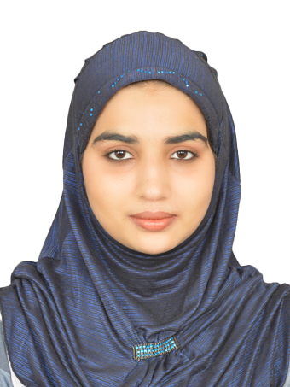

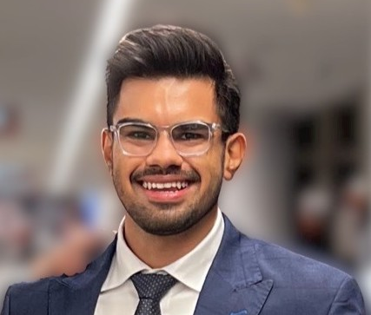
Teaching assistants
Tutorials: Starting Week 3
We have amazing teaching assistants to help with the course:
Malaika Afra Taj (PhD Student, SoC)
Kanav Sabharwal (PhD Student, SoC)
Ayanga Kalupahana (PhD Student SoC)
Notes:
++ We may all have heard of the term Internet of Things. So how are these wireless embedded systems related to the Internet of Things: Today, IoT includes a broad class of devices, including powerful platforms such as smartphones. However, it also includes more resource-constrained devices and what we call Wireless Embedded Systems, and in fact, I consider it to be one of the essential parts of the IoT ecosystem.
++ These are platforms equipped with a radio transceiver, sensor, microcontroller, and some form of energy storage. These platforms also often form a network, and sensor network as it is called has been an active area of research for the past two decades.
++ The research community has also developed wireless embedded platforms which we may know about, and these include: CMUCAM, which is an image sensor platform developed at Carnegie Mellon University, or Permamote is long life sensor platform from the lab I am associated with at UC Berkeley or Lorea which is a long-range backscatter platform that I had developed as part of my doctoral dissertation at Uppsala University. All of these are an example of Wireless Embedded Systems.

Slide 12
Course homepage and webcast of lectures
Course homepage and other information can be found on following links:
Canvas (updated less frequently)
(Frequent updates) Link: https://weiserlab.github.io/ambuj/cs4222
Will aim to upload presentation slides before the lecture date
Webcast: Not planned. Important parts of lecture uploaded to YouTube
Lecture videos could be uploaded after the lecture has happened
Notes:
++ We may all have heard of the term Internet of Things. So how are these wireless embedded systems related to the Internet of Things: Today, IoT includes a broad class of devices, including powerful platforms such as smartphones. However, it also includes more resource-constrained devices and what we call Wireless Embedded Systems, and in fact, I consider it to be one of the essential parts of the IoT ecosystem.
++ These are platforms equipped with a radio transceiver, sensor, microcontroller, and some form of energy storage. These platforms also often form a network, and sensor network as it is called has been an active area of research for the past two decades.
++ The research community has also developed wireless embedded platforms which we may know about, and these include: CMUCAM, which is an image sensor platform developed at Carnegie Mellon University, or Permamote is long life sensor platform from the lab I am associated with at UC Berkeley or Lorea which is a long-range backscatter platform that I had developed as part of my doctoral dissertation at Uppsala University. All of these are an example of Wireless Embedded Systems.

Slide 13
Evaluation criteria for CS4222/5222
Continuous Assignments (70%)
programming assignments + projects TBA
2 individual programming assignments TBA
Groups of 2 to 4 members
2 group programming assignments (TBA)
1 group project (TBA)
Written Assignment 10%
Tutorial 5%
Final Assessment, open book (30%)

Slide 14
Other details, including programming assignments
Would provide prompts for OpenAI ChatGPT
Early technology, many times gives wrong answer. Be careful!
At this stage only a supplement to other resources
Detailed course outline (to be uploaded on homepage)
Details on programming assignment next week!
Feel free to reach out regarding any questions you may have

Slide 15
This Course?
Notes:
++ Over the past few years, I have designed several backscatter and beyond backscatter systems that precisely overcome these critical challenges that have limited the widespread deployment of backscatter on IoT devices.
++ The research vision that I have pursued and would like to pursue as a faculty member is to enable a massive deployment of IoT devices by bridging the energy asymmetry between sensing, computation and communication blocks by designing novel platforms and communication mechanisms. I am going to describe some of my research contributions next.

Slide 16
Course Information
This course teaches the basics of wireless networking, various wireless standards and also emerging technologies, protocols, energy challenge, and programming sensor (IoT) devices and conducting experiments
Focus of the course is on emerging computing systems: Internet of Things
Notes:
Why do the IoT platforms suffer from this energy challenge? To understand this, we investigate the architecture of the IoT device. We show this architecture in the figure on the slide. It consists of a series of stages that enable us to sense physical phenomena, process and transmit the sensor information through a transceiver such as ZigBee/BLE/LoRa.
This architecture has remained unchanged over the past two decades. We find that during this time, sensors have become exceeding efficient. Today, we find sensors such as an accelerometer or a temperature sensor consumes just a few tens of microwatts of power consumption. However, we find that rest of the architecture components that are shown in red colour remain significantly energy expensive. To understand the reason for this significant energy asymmetry, we look at the following slide.

Slide 17
Do you know what the Internet of Things is? How does Internet of Things impact you?
Notes:
++ Over the past few years, I have designed several backscatter and beyond backscatter systems that precisely overcome these critical challenges that have limited the widespread deployment of backscatter on IoT devices.
++ The research vision that I have pursued and would like to pursue as a faculty member is to enable a massive deployment of IoT devices by bridging the energy asymmetry between sensing, computation and communication blocks by designing novel platforms and communication mechanisms. I am going to describe some of my research contributions next.

Slide 18
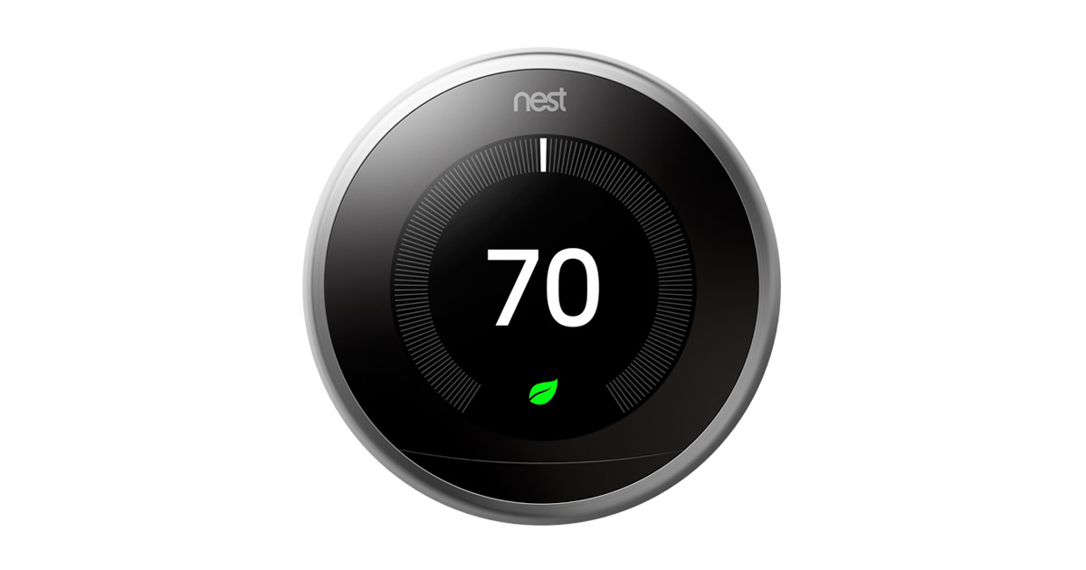
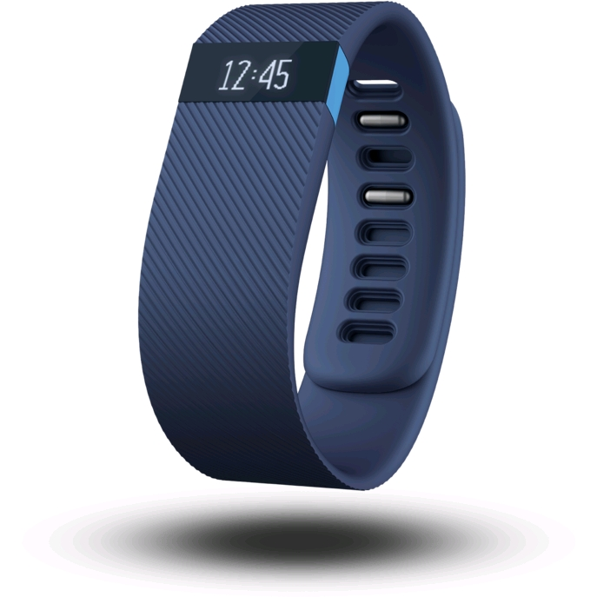
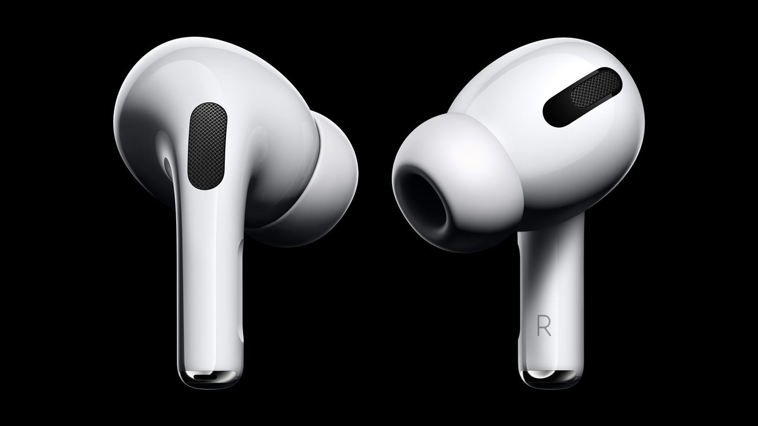
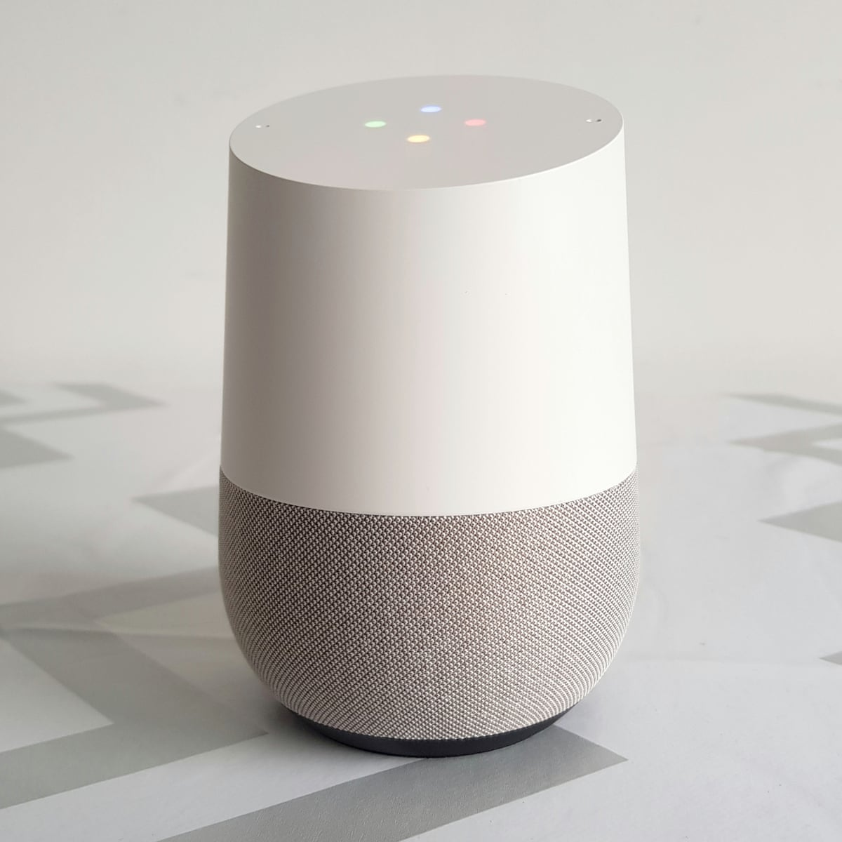
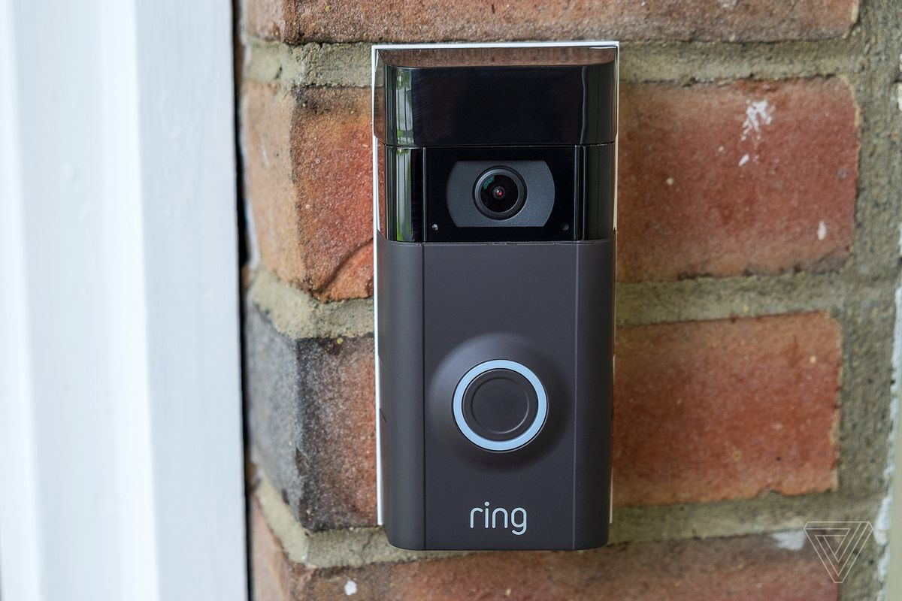
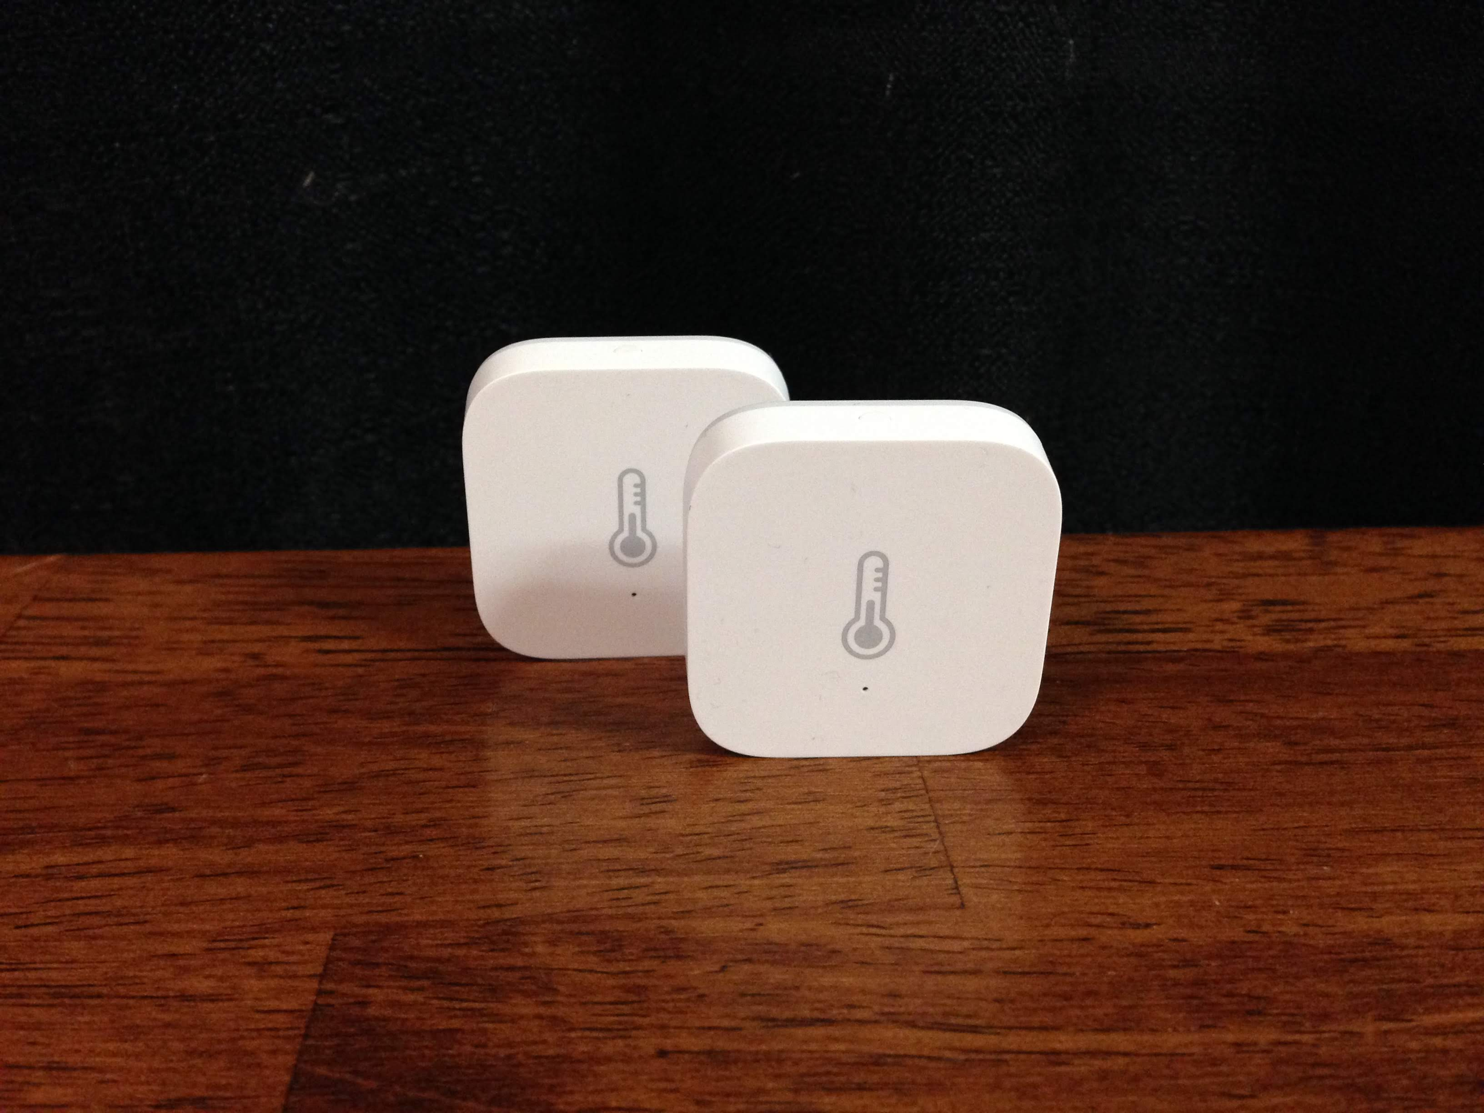
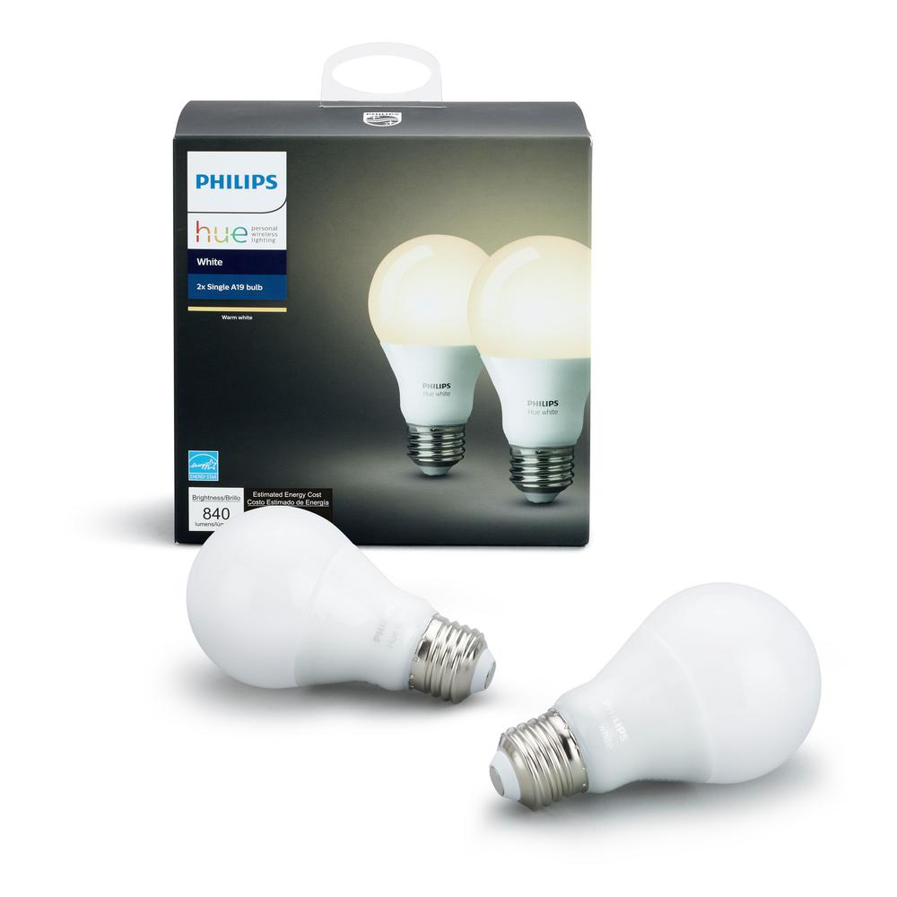
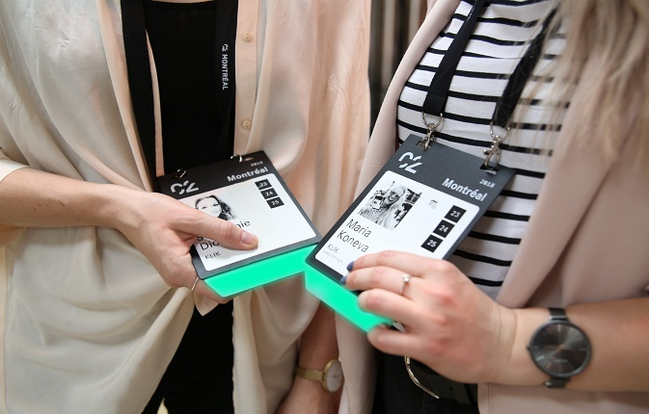
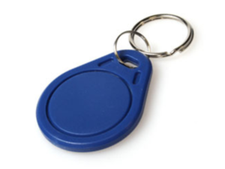
Internet of things devices are all around us...
Google nest thermostat
Fitbit activity tracker
Apple airpods
Smart speaker
Ring doorbell
Xiaomi temperature sensor
Philips hue smart bulb
Smart badges
BLE proximity beacon
Notes:
+ I begin this presentation by demonstrating devices that we interact with within our daily lives. These include Fitbit, AirPods, smart speakers or ble proximity beacons that we attach to objects such as keychain to keep track of them. All of these are examples of wireless embedded systems.

Slide 19
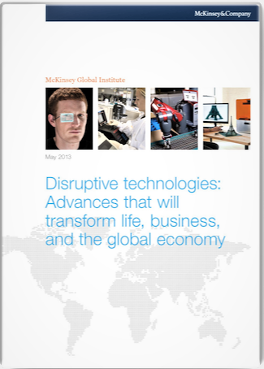
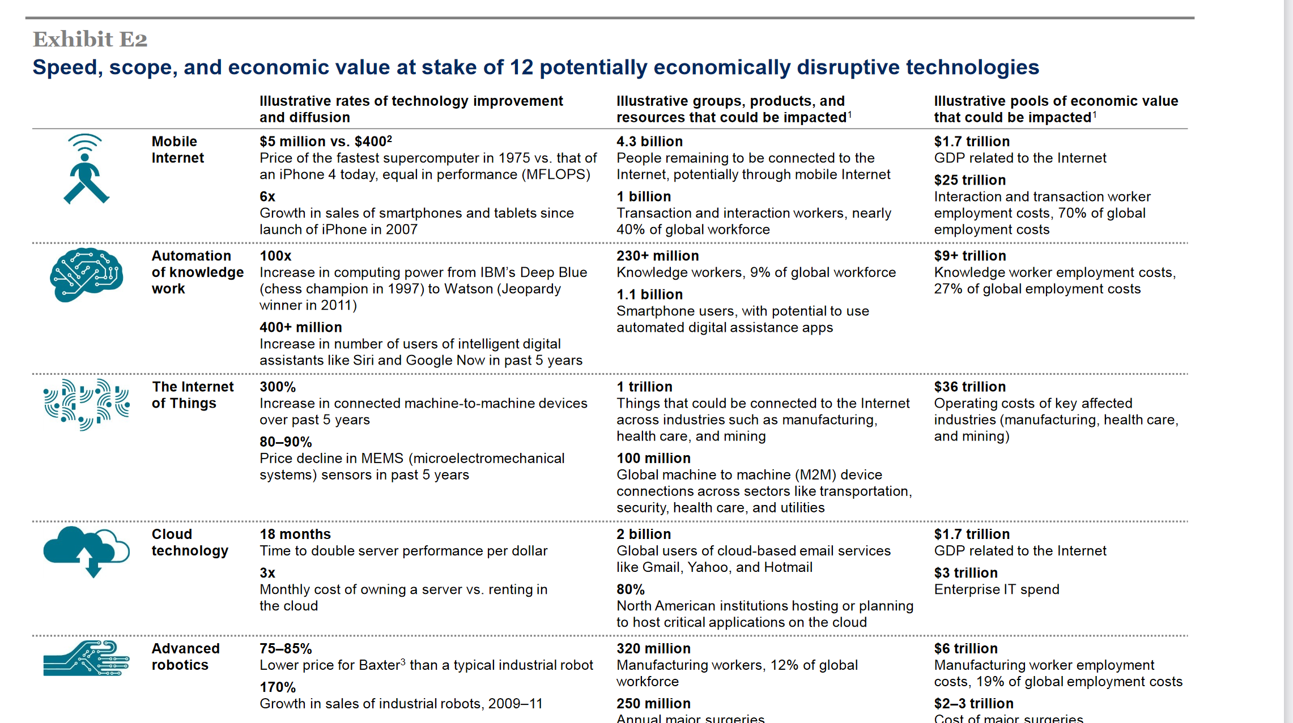
Internet of things will be bigger than cloud computing
Disruptive technologies: Advances that will transform life, business, and the global economy - McKinsey Global Institute (2013)
Notes:
So how big would the Internet of Things be?
We investigate a report from McKinsey called Disruptive Technologies which claims that the IoT would influence the combined economic value well over 36 trillion, far higher than cloud technology. Hence, this rapid growth in the IoT that we are witnessing is placing us on a pathway towards eclipsing (in economic value) major trends from previous decades, such as the cloud computing.

Slide 20
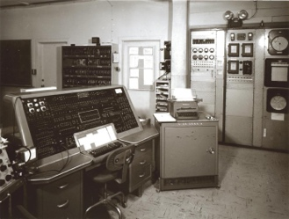
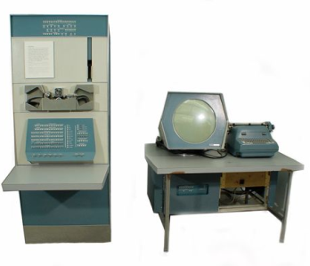
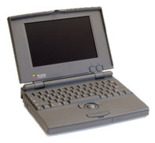
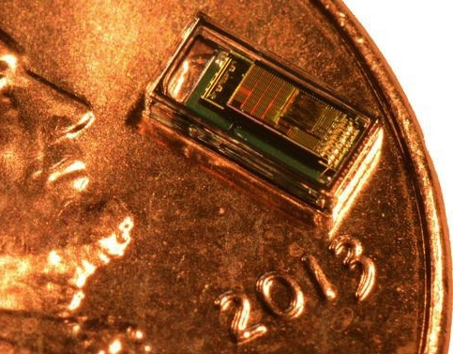
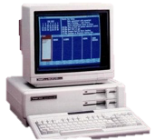

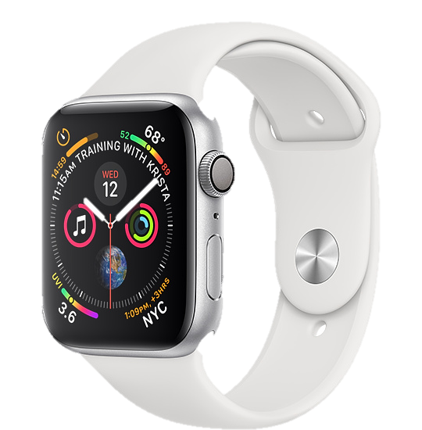
Trillion embedded devices will be deployed soon
Mainframe
“Roughly every decade a new, lower priced computer class forms based on a new programming platform, network, and interface resulting in new usage and the establishment of a new industry.”
1 per Enterprise
Workstation
1 per Engineer
[Bell et al. Computer, 1972, ACM, 2008]
Smart Dust
Laptop
100 – 1000’s per person
log (people per computer)
1 per Professional
IoT/Wearable
Mini Computer
10’s per person
1 per Company
Personal Computer
1 per Family
Smartphone
1 per person

Slide 21
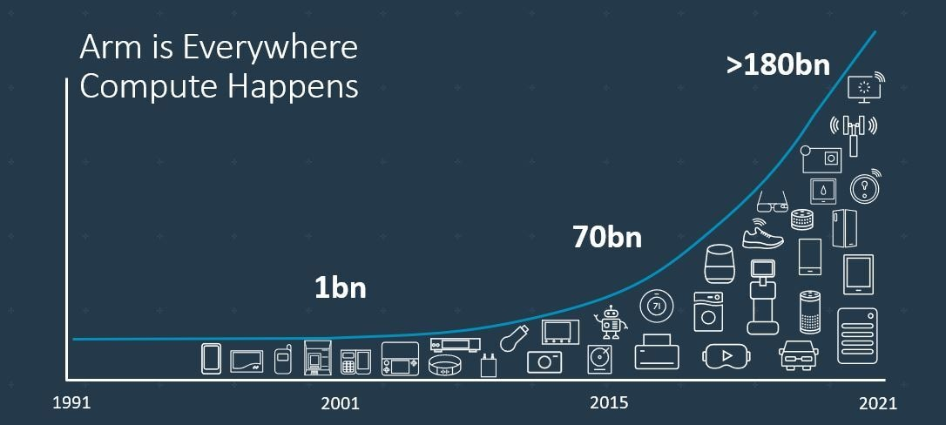
Trillion embedded devices will be deployed soon
Fourth quarter of 2020. Arm shipped 4.4 billion Cortex-M processors
ARM Press Release (Feb 11, 2021) reporting on Fourth Quarter 2020
Notes:
++ Due to the numerous applications that the internet of things enables, we are witnessing a massive growth in the number of microcontrollers being sold. These microcontrollers form the heart of the IoT platforms.
++ To illustrate this point: ARM, a popular UK based company, just reported numbers, and in these numbers, they state that they sold 4.4 billion cortex M processors in just one quarter. These microcontrollers are almost exclusively used on IoT platforms, which demonstrates the massive growth we are witnessing in the number of deployed IoT devices.
++ If this growth continues, and in fact, I believe this growth will accelerate, we will soon have a trillion embedded devices that are going to be deployed in the world.

Slide 22
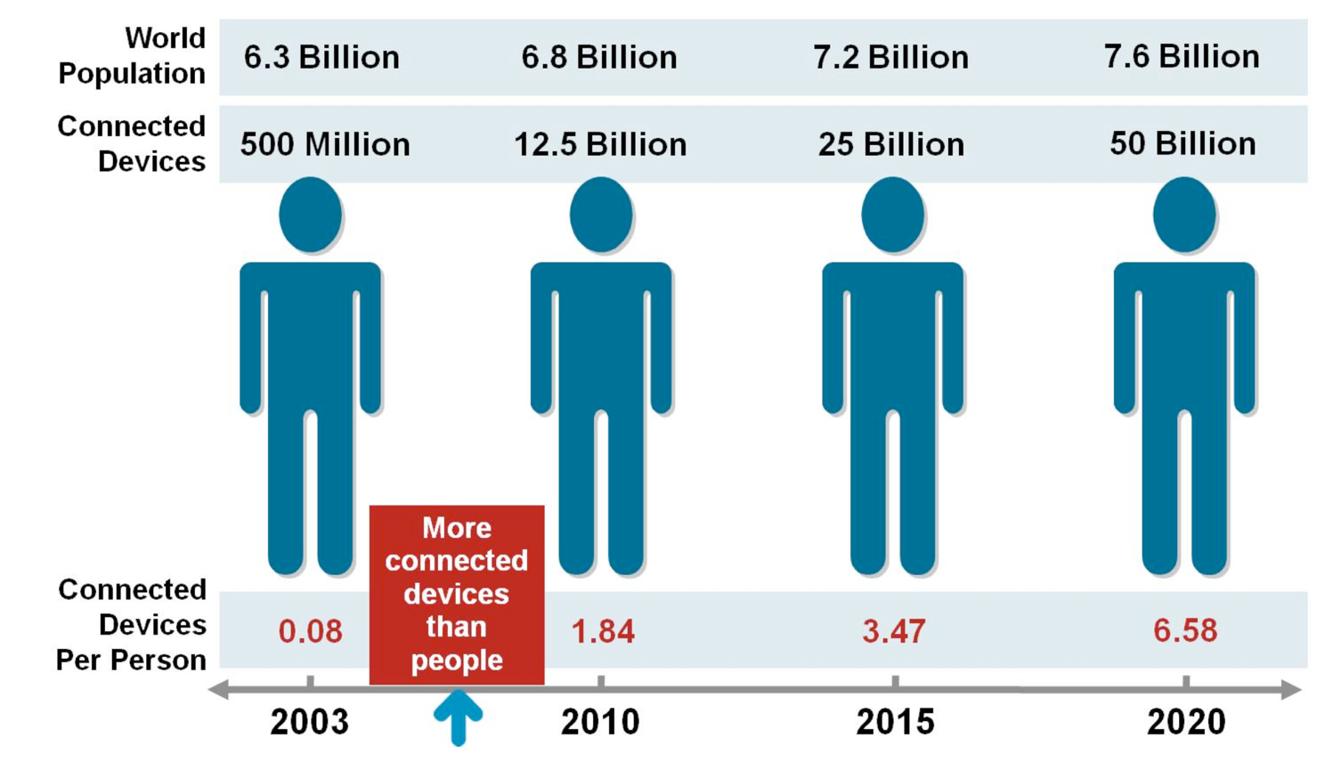
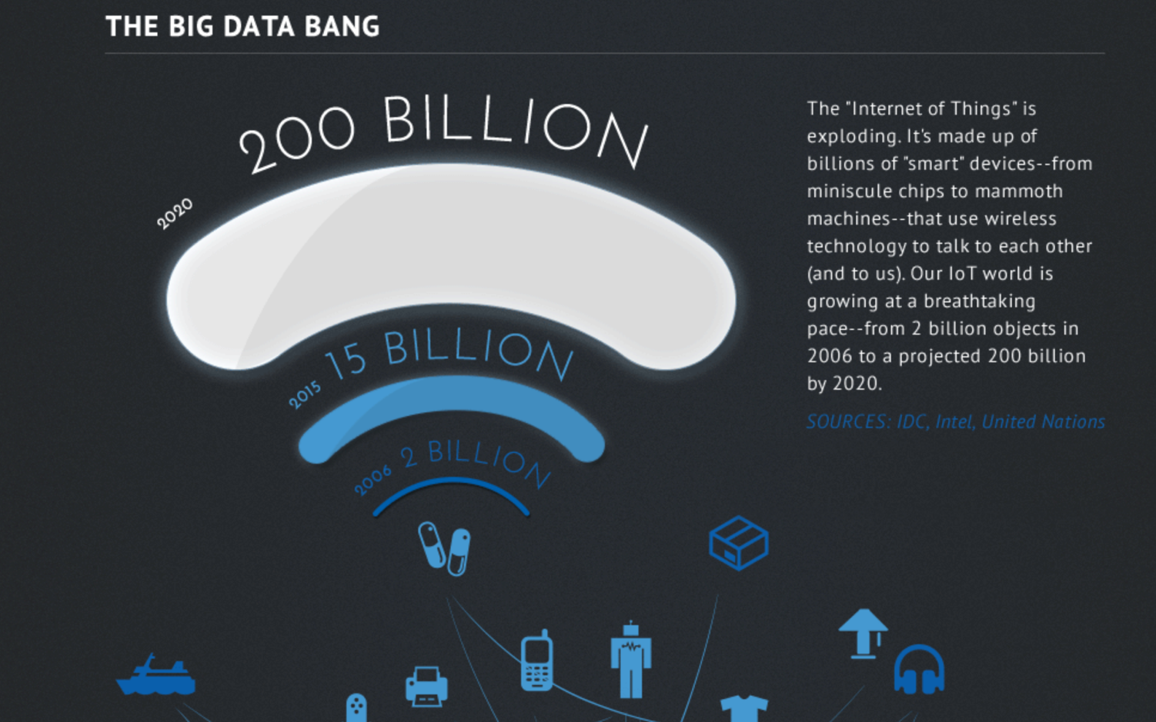
Other predictions about IoT scale
Courtesy: CISCO
Courtesy: Intel
Notes:
So how big would the Internet of Things be?
We investigate a report from McKinsey called Disruptive Technologies which claims that the IoT would influence the combined economic value well over 36 trillion, far higher than cloud technology. Hence, this rapid growth in the IoT that we are witnessing is placing us on a pathway towards eclipsing (in economic value) major trends from previous decades, such as the cloud computing.

Slide 23
However, this rapid growth may stop!
Notes:
++ Over the past few years, I have designed several backscatter and beyond backscatter systems that precisely overcome these critical challenges that have limited the widespread deployment of backscatter on IoT devices.
++ The research vision that I have pursued and would like to pursue as a faculty member is to enable a massive deployment of IoT devices by bridging the energy asymmetry between sensing, computation and communication blocks by designing novel platforms and communication mechanisms. I am going to describe some of my research contributions next.

Slide 24
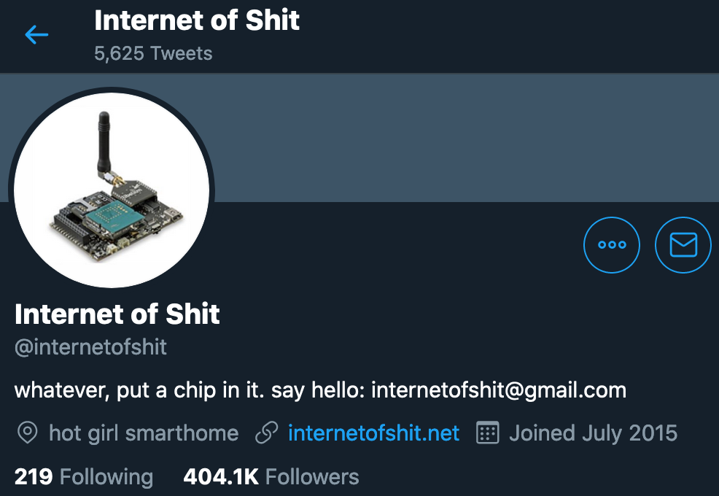
Word of caution: Mind the hype

Slide 25
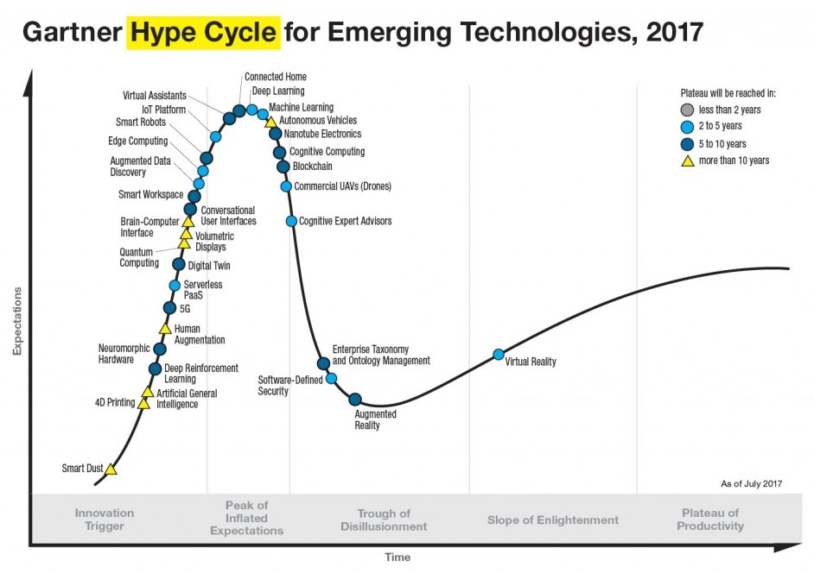
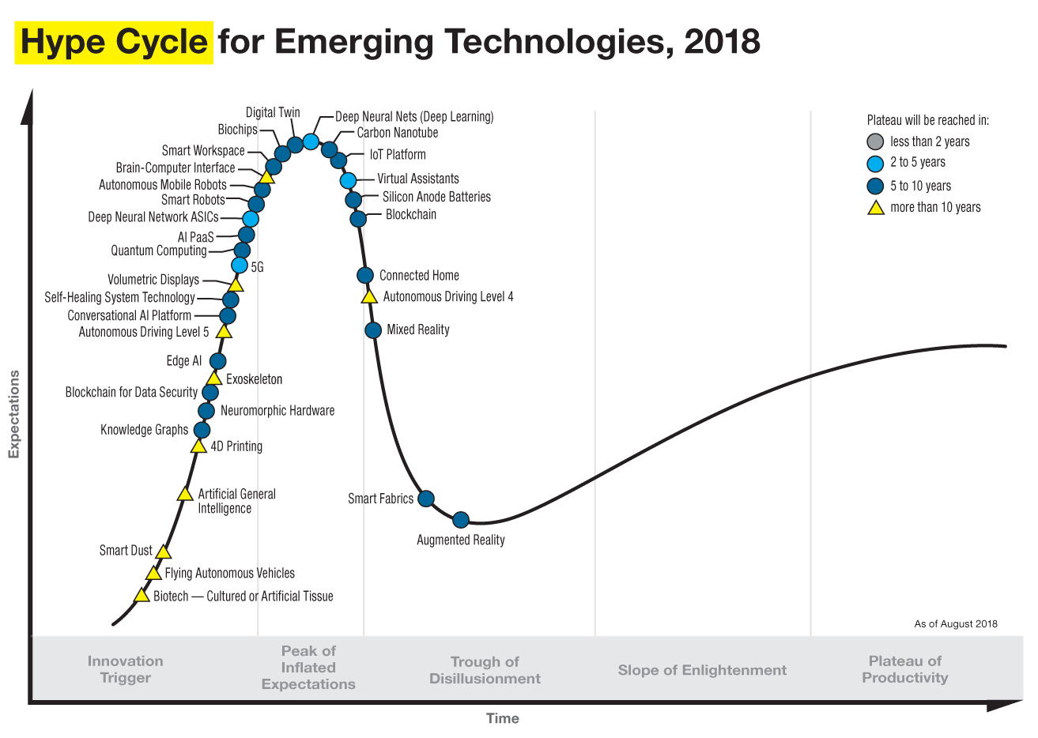
Word of caution: Mind the hype

Slide 26
Internet of things has an energy challenge
Notes:
++ Over the past few years, I have designed several backscatter and beyond backscatter systems that precisely overcome these critical challenges that have limited the widespread deployment of backscatter on IoT devices.
++ The research vision that I have pursued and would like to pursue as a faculty member is to enable a massive deployment of IoT devices by bridging the energy asymmetry between sensing, computation and communication blocks by designing novel platforms and communication mechanisms. I am going to describe some of my research contributions next.

Slide 27
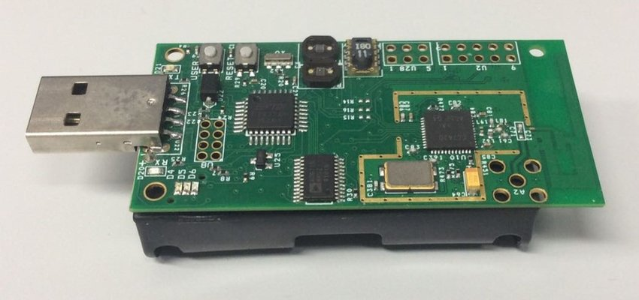
IoT devices are energy expensive, battery-operated
Internet of things devices are extremely energy expensive:
Operate on bulky batteries. Frequent replacement. Challenging at scale
Challenging to realize novel form factor for the platform (sticker)
Energy challenge is biggest hindrance to unlocking trillions of dollars economic value enabled through the massive deployment of IoT devices
TelOS B Sensor node (Powered by AA batteries)
Flexible backscatter tag based on LoRea (SENSYS 2017)
Notes:
++ While we are deploying an enormously large number of IoT devices, I claim that very little attention is being paid to their energy challenge.
++ Today, most IoT devices are very energy expensive, and consequently, they rely on bulky batteries such as AA/AAA sized batteries for their operation. Even when operating on these batteries, they require frequent replacement of the exhausted batteries. This can be challenging when performed at a massive scale, especially considering that we may have a trillion embedded device deployed in the world.
++ Further, it can also harm the environment. These batteries use toxic chemicals, which means now we can have billions of toxic chemicals laden batteries that would be disposed of in landfills. This is especially important as sustainability has become an essential aspect across the world; in fact, imperial college was celebrating sustainability week.

Slide 28

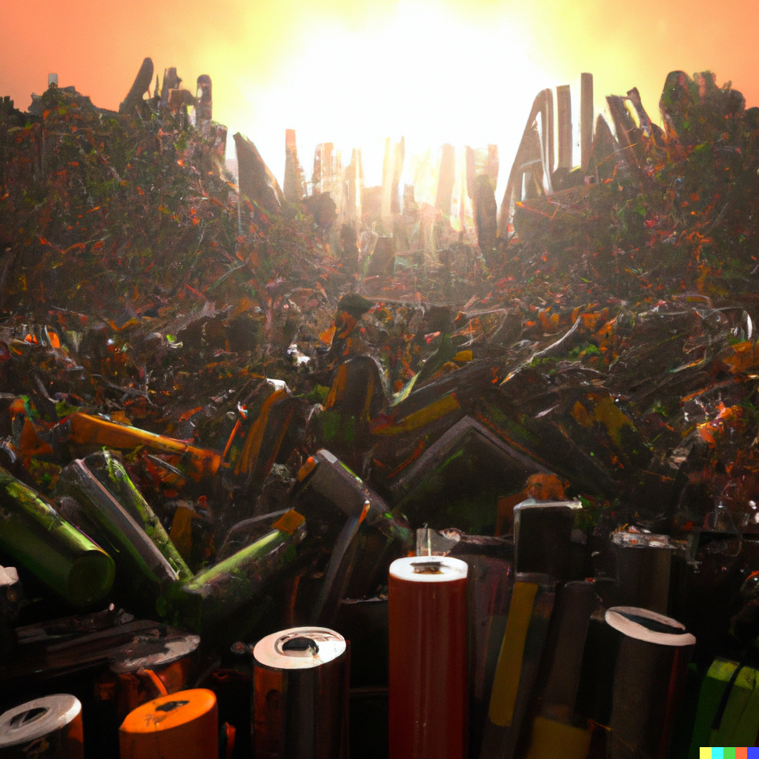
Internet of things has an energy challenge
Notes:
++ While we are deploying an enormously large number of IoT devices, I claim that very little attention is being paid to their energy challenge.
++ Today, most IoT devices are very energy expensive, and consequently, they rely on bulky batteries such as AA/AAA sized batteries for their operation. Even when operating on these batteries, they require frequent replacement of the exhausted batteries. This can be challenging when performed at a massive scale, especially considering that we may have a trillion embedded device deployed in the world.
++ Further, it can also harm the environment. These batteries use toxic chemicals, which means now we can have billions of toxic chemicals laden batteries that would be disposed of in landfills. This is especially important as sustainability has become an essential aspect across the world; in fact, imperial college was celebrating sustainability week.

Slide 29
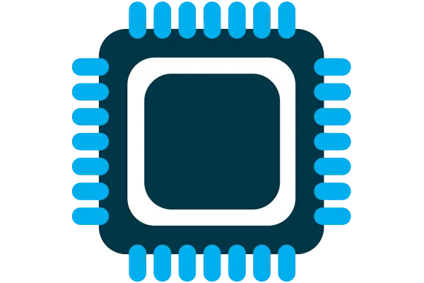



Four major components of IoT device
Computation and Storage
Sensing and Actuation
Power
Wireless Networking
Notes:
First, we look at the computational elements, and these consist of a microcontroller or an FPGA. Today, we find that these computational elements consume at least one order of magnitude higher power consumption when compared to the commonly used sensors.
However, we also find that microcontrollers are increasingly becoming energy efficient. We investigate a typical microcontroller that has been used in sensor platforms over the past two decades. We find that energy efficiency has improved by almost two orders of magnitude. Some of the present-generation microcontrollers, such as Ambiq Apollo4 consume just 3 uA/MHz than 330 uA for MSP430 used on platforms such as TelOS B.
If the trend continues, we can expect the microcontrollers to catch up with the sensors and become energy-efficient. This significant improvement is that the digital components are increasing becoming efficient as they follow moore’s law.

Slide 30
Four major components of IoT device
Computation and Storage
Sensing and Actuation
Power
Wireless Networking
Notes:
First, we look at the computational elements, and these consist of a microcontroller or an FPGA. Today, we find that these computational elements consume at least one order of magnitude higher power consumption when compared to the commonly used sensors.
However, we also find that microcontrollers are increasingly becoming energy efficient. We investigate a typical microcontroller that has been used in sensor platforms over the past two decades. We find that energy efficiency has improved by almost two orders of magnitude. Some of the present-generation microcontrollers, such as Ambiq Apollo4 consume just 3 uA/MHz than 330 uA for MSP430 used on platforms such as TelOS B.
If the trend continues, we can expect the microcontrollers to catch up with the sensors and become energy-efficient. This significant improvement is that the digital components are increasing becoming efficient as they follow moore’s law.

Slide 31
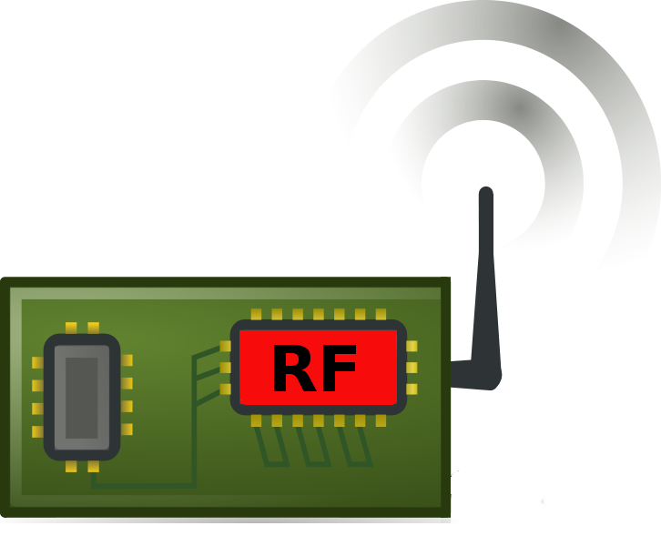
Communication remains a significant challenge
Performing communication remains orders of magnitude more energy expensive than performing sensing and computation
No scaling in power consumption due to Moore’s law. Energy expensive
Component | Power Consumption
Microcontroller (Apollo3) | 100s of µW’s (48 to 192 MHz)
Sensors | Few to tens of µW’s
Transceiver | Tens to Hundreds of mW’s
Power scaled with Moore’s law O(10 uW)
No such scaling O(100 mW)
Digital
(Baseband)
Analog
(RF)
Notes:
++ Due to the following of Moore’s law, we find that the microcontrollers are bridging the gap between sensing and computation. However, we find that communication remains a challenge and the most expensive IoT platforms' operation. Today the transceivers employed to perform communication consumes orders of magnitude higher energy when compared to performing sensing and processing operation.
++ Why are the communication blocks not witnessing such a dramatic decrease in power consumption? To understand this, we investigate the high-level diagram of the communication block. It consists of digital baseband generation circuitry and an analog front end. Due to the following of Moore’s law, digital baseband circuitry is becoming energy efficient. However, we do not witness any such scaling for the analog components. This causes these analog blocks to remain extremely energy expensive, pushing the power consumption for performing transmissions to be tens to hundreds of milliwatts. As an example, radio transceivers such as LoRa consume hundreds of milliwatts of power consumption. This is precisely the reason that present day IoT platforms operate with limited lifetime even on bulky and energy dense batteries.

Slide 32
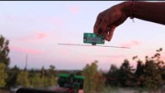
Reflecting TV Signals for Transmissions
Courtesy: University of Washington, Seattle
Ambient Backscatter: Wireless Communication Out of Thin Air, ACM SIGCOMM 2013

Slide 33
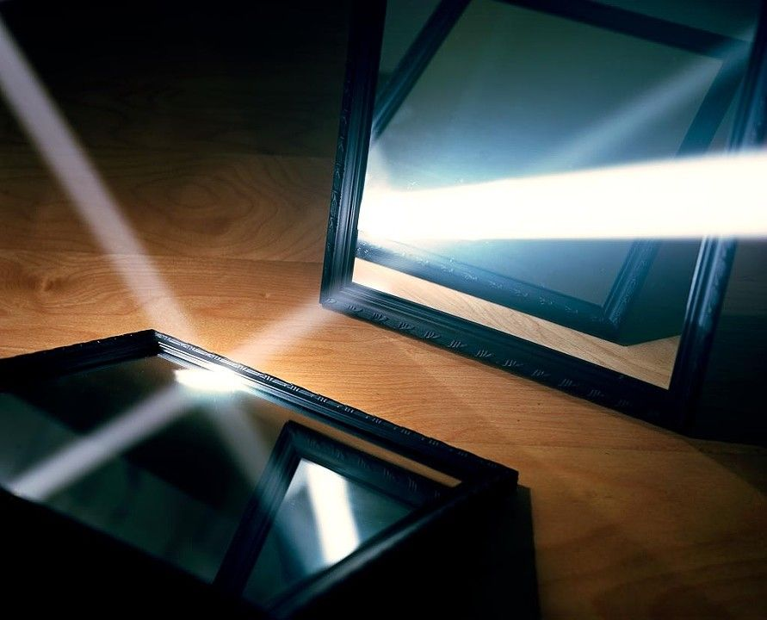
One way to understand backscatter transmissions
Notes:
++ While we are deploying an enormously large number of IoT devices, I claim that very little attention is being paid to their energy challenge.
++ Today, most IoT devices are very energy expensive, and consequently, they rely on bulky batteries such as AA/AAA sized batteries for their operation. Even when operating on these batteries, they require frequent replacement of the exhausted batteries. This can be challenging when performed at a massive scale, especially considering that we may have a trillion embedded device deployed in the world.
++ Further, it can also harm the environment. These batteries use toxic chemicals, which means now we can have billions of toxic chemicals laden batteries that would be disposed of in landfills. This is especially important as sustainability has become an essential aspect across the world; in fact, imperial college was celebrating sustainability week.

Slide 34
Long range backscatter transmissions using LoRea
LoRea is a long range, low-power, and low-cost backscatter architecture
System Overview
Backscatter Tag Hardware Prototype
(Peak Power of 70 µW)
Varshney et al. ”LoRea: A Backscatter architecture that achieves a long communication range” ACM SENSYS 2017
Notes:
+ Over the past several years, I have designed systems that overcome these critical limitations that have hindered the backscatter systems and have the prevented widespread adoption of the backscatter mechanisms on the Internet of Things devices. One of these systems is LoRea.
+ LoRea was presented at ACM SENSYS, which is a flagship conference in the area of embedded sensor systems. I show the architecture of LoRea on the left-hand figure on the slide. It consists of one or more commodity devices such as a smartphone or Wi-Fi router that provides the necessary carrier signal to support backscatter transmissions, a low-power backscatter tag that I had designed and transmit at a peak power of 70uw, and one or more receiver of backscatter transmissions.
+ The key highlight of LoRea was that it could achieve a significantly larger communication range than existing systems, was designed using off the shelf components and cost (few tens of USDs). Further, the backscatter tag could achieve this capability at orders of magnitude lower energy than commercially available radio transceivers.
+ How did LoRea achieve this capability? We would describe next.

Slide 35
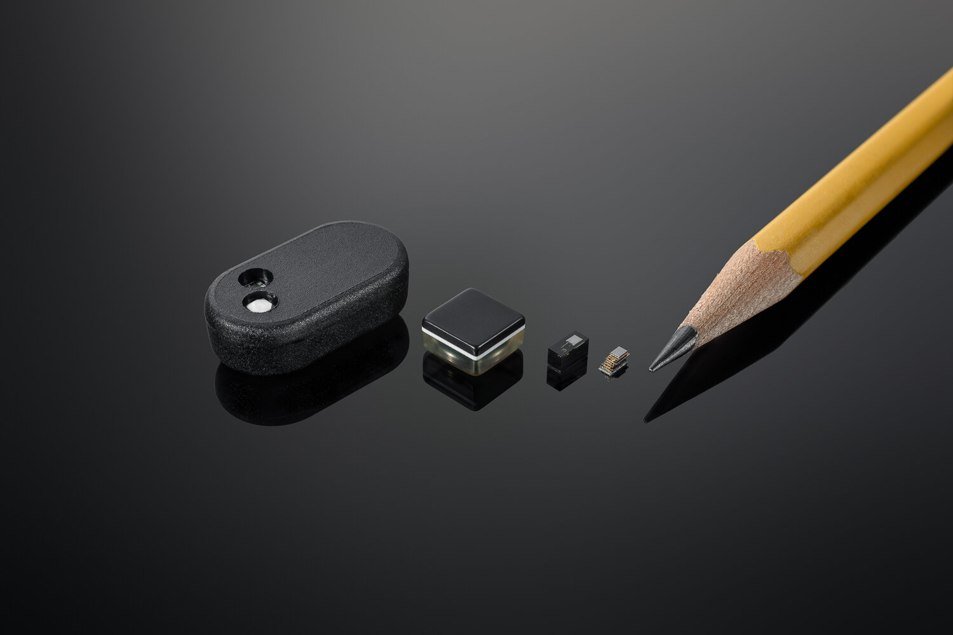
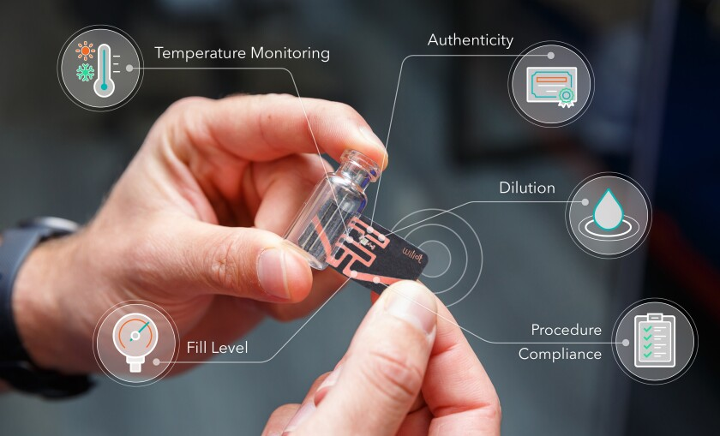
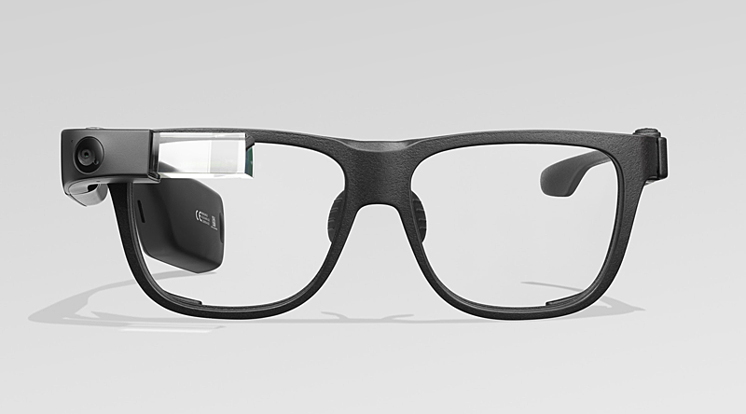
Where are we right now?

Slide 36
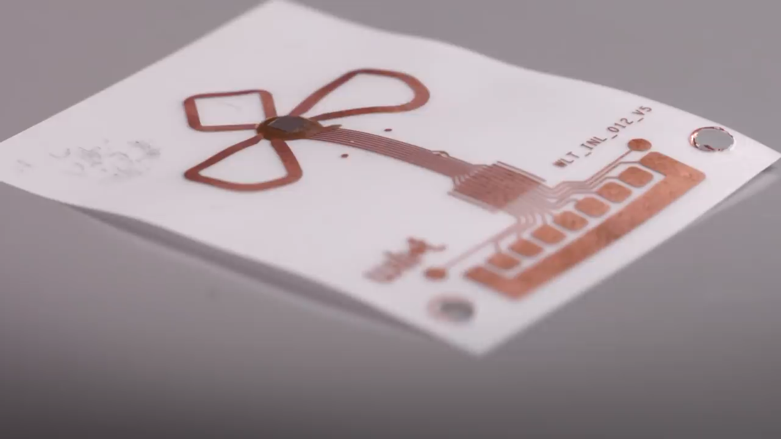
WilIoT: battery-free, bluetooth, stickersç
Notes:
++ We may all have heard of the term Internet of Things. So how are these wireless embedded systems related to the Internet of Things: Today, IoT includes a broad class of devices, including powerful platforms such as smartphones. However, it also includes more resource-constrained devices and what we call Wireless Embedded Systems, and in fact, I consider it to be one of the essential parts of the IoT ecosystem.
++ These are platforms equipped with a radio transceiver, sensor, microcontroller, and some form of energy storage. These platforms also often form a network, and sensor network as it is called has been an active area of research for the past two decades.
++ The research community has also developed wireless embedded platforms which we may know about, and these include: CMUCAM, which is an image sensor platform developed at Carnegie Mellon University, or Permamote is long life sensor platform from the lab I am associated with at UC Berkeley or Lorea which is a long-range backscatter platform that I had developed as part of my doctoral dissertation at Uppsala University. All of these are an example of Wireless Embedded Systems.

Slide 37
Break! (5 minutes)
Notes:
++ Over the past few years, I have designed several backscatter and beyond backscatter systems that precisely overcome these critical challenges that have limited the widespread deployment of backscatter on IoT devices.
++ The research vision that I have pursued and would like to pursue as a faculty member is to enable a massive deployment of IoT devices by bridging the energy asymmetry between sensing, computation and communication blocks by designing novel platforms and communication mechanisms. I am going to describe some of my research contributions next.

Slide 38
History and Growth of Wireless Communication
Notes:
++ Over the past few years, I have designed several backscatter and beyond backscatter systems that precisely overcome these critical challenges that have limited the widespread deployment of backscatter on IoT devices.
++ The research vision that I have pursued and would like to pursue as a faculty member is to enable a massive deployment of IoT devices by bridging the energy asymmetry between sensing, computation and communication blocks by designing novel platforms and communication mechanisms. I am going to describe some of my research contributions next.

Slide 39
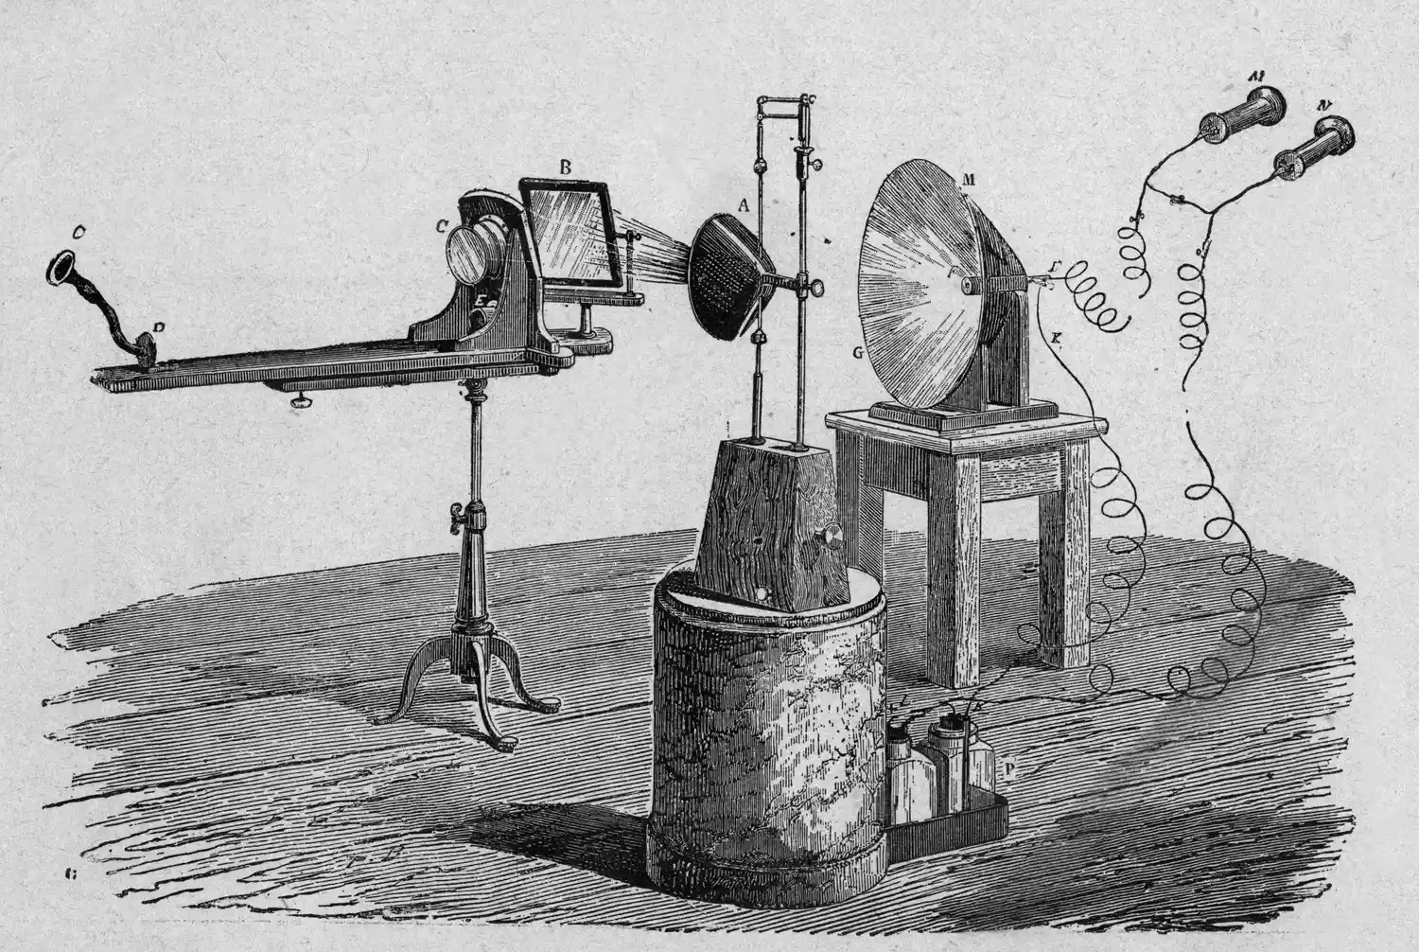
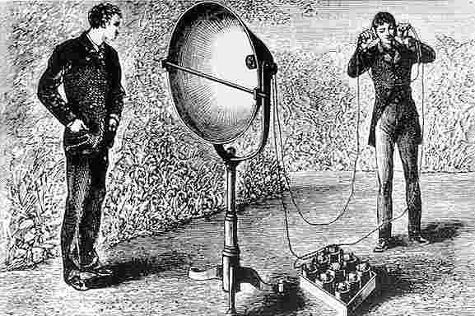
History of Wireless Transmissions
History of wireless: Who was the first to invent and demonstrate wireless communication is disputed
1880: Alexander Graham Bell and his assistant Charles Sumner Tainter at Bell Labs invented the photophone
This device transmitted sound on beam of light
Notes:
First, we look at the computational elements, and these consist of a microcontroller or an FPGA. Today, we find that these computational elements consume at least one order of magnitude higher power consumption when compared to the commonly used sensors.
However, we also find that microcontrollers are increasingly becoming energy efficient. We investigate a typical microcontroller that has been used in sensor platforms over the past two decades. We find that energy efficiency has improved by almost two orders of magnitude. Some of the present-generation microcontrollers, such as Ambiq Apollo4 consume just 3 uA/MHz than 330 uA for MSP430 used on platforms such as TelOS B.
If the trend continues, we can expect the microcontrollers to catch up with the sensors and become energy-efficient. This significant improvement is that the digital components are increasing becoming efficient as they follow moore’s law.

Slide 40
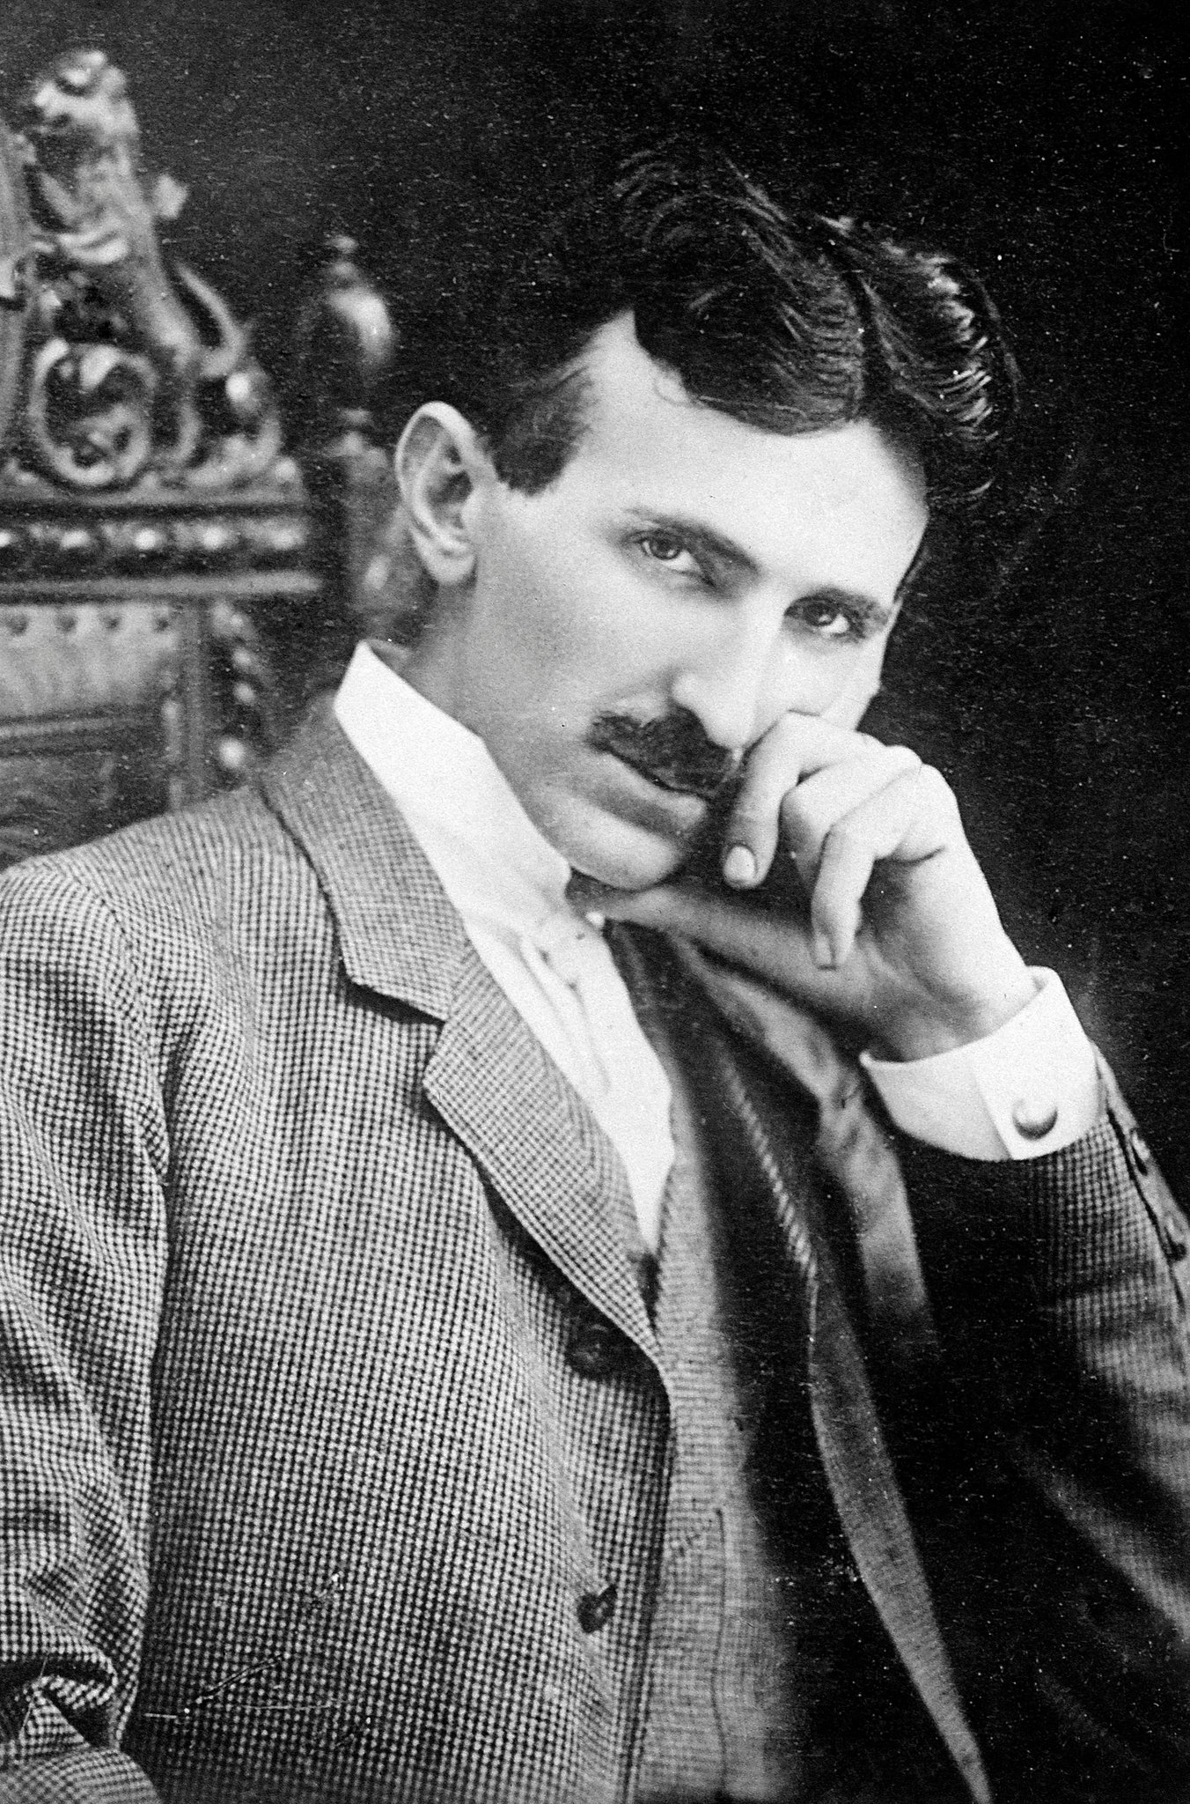

History of Wireless Transmissions
History of wireless: Who was the first to invent and demonstrate wireless communication is disputed
1893: Nikola Tesla gave a public demonstration of "wireless" radio communication at St. Louis, Missouri, USA
Notes:
First, we look at the computational elements, and these consist of a microcontroller or an FPGA. Today, we find that these computational elements consume at least one order of magnitude higher power consumption when compared to the commonly used sensors.
However, we also find that microcontrollers are increasingly becoming energy efficient. We investigate a typical microcontroller that has been used in sensor platforms over the past two decades. We find that energy efficiency has improved by almost two orders of magnitude. Some of the present-generation microcontrollers, such as Ambiq Apollo4 consume just 3 uA/MHz than 330 uA for MSP430 used on platforms such as TelOS B.
If the trend continues, we can expect the microcontrollers to catch up with the sensors and become energy-efficient. This significant improvement is that the digital components are increasing becoming efficient as they follow moore’s law.

Slide 41

History of Wireless Transmissions
History of wireless: Who was the first to invent and demonstrate wireless communication is disputed
1896: Guglielmo Marconi's first radio transmissions, coded signals that were transmitted only about 1.6 km (a mile)
1899: Marconi sends a signal over the English Channel ~50km
Notes:
First, we look at the computational elements, and these consist of a microcontroller or an FPGA. Today, we find that these computational elements consume at least one order of magnitude higher power consumption when compared to the commonly used sensors.
However, we also find that microcontrollers are increasingly becoming energy efficient. We investigate a typical microcontroller that has been used in sensor platforms over the past two decades. We find that energy efficiency has improved by almost two orders of magnitude. Some of the present-generation microcontrollers, such as Ambiq Apollo4 consume just 3 uA/MHz than 330 uA for MSP430 used on platforms such as TelOS B.
If the trend continues, we can expect the microcontrollers to catch up with the sensors and become energy-efficient. This significant improvement is that the digital components are increasing becoming efficient as they follow moore’s law.

Slide 42

Early milestones for wireless communication
1901: Trans-Atlantic transmission from England to Newfoundland (>3000km)

Slide 43
Early milestones for wireless communication
1906: (AM radio) first audio broadcast of music/voice from shore to ship
1912: The RMS Titanic sank. After this, wireless telegraphy quickly became universal on large ships
1915: AT&T sent speech from Arlington (Virginia) to Paris (>6,000km)

Slide 44
History of Audio/Video broadcasting
1916: Regular broadcast of weather information using Morse code
1917 - 1919: Clear transmission of music, voice and human speech
Early Radio Stations
1922: France, UK
1936: Malaya, Singapore
1935: Frequency modulation (FM) demonstrated by Armstrong
1980s: Digital Audio Broadcasting (DAB)

Slide 45
History of Television Broadcasting
1923: First wireless TV transmission
1941: NTSC (National Television System Committee), 525 lines per inch at 30 fps in a bandwidth of 6 MHz
1962: AT&T launches Telstar, the first satellite to carry TV broadcasts
1963: PAL or Phase Alternating Line standardized, uses 625 lines
1963: First TV broadcast in Singapore (channel 5)‏
1996: US. HDTV standardized

Slide 46
History of Voice and Cellular Communication
1946 - First interconnection of mobile users to public switched telephone network (PSTN), “zero” generation
1983 - Advanced Mobile Phone System (AMPS) deployed in US in 900 MHz band
1989 - Groupe Spècial Mobile defines European digital cellular standard, GSM
1993 - IS-95 code-division multiple-access (CDMA) digital cellular system deployed in US

Slide 47

Communication Technology Adoption in the USA
Data Source: Radio penetration data per Broadcasting & Cable Yearbook 1996, Internet penetration data per World Bank/ITU, Mobile Internet (smartphone) data per Morgan Stanley Research; 3G data per Informa.

Slide 48

Communication Technology Adoption
Source: Cisco Annual Internet Report, 2018–2023
https://www.cisco.com/c/en/us/solutions/collateral/executive-perspectives/annual-internet-report/white-paper-c11-741490.html

Slide 49

5G Network Growth
https://omdia.tech.informa.com/pr/2021-oct/5g-networks-still-to-reach-market-penetration-tipping-point-finds-omdia-research

Slide 50
Basics of Wireless Communication
Notes:
++ Over the past few years, I have designed several backscatter and beyond backscatter systems that precisely overcome these critical challenges that have limited the widespread deployment of backscatter on IoT devices.
++ The research vision that I have pursued and would like to pursue as a faculty member is to enable a massive deployment of IoT devices by bridging the energy asymmetry between sensing, computation and communication blocks by designing novel platforms and communication mechanisms. I am going to describe some of my research contributions next.

Slide 51
What are wireless radios?
Radios are electronic devices that enables wireless transmission of signals
Electromagnetic signal is modulated and radiated out of the antenna
Wireless transmissions are then received by a receiver radio device
Antenna
Radio frequency signal
Radio transmitter
Radio receiver
Notes:
First, we look at the computational elements, and these consist of a microcontroller or an FPGA. Today, we find that these computational elements consume at least one order of magnitude higher power consumption when compared to the commonly used sensors.
However, we also find that microcontrollers are increasingly becoming energy efficient. We investigate a typical microcontroller that has been used in sensor platforms over the past two decades. We find that energy efficiency has improved by almost two orders of magnitude. Some of the present-generation microcontrollers, such as Ambiq Apollo4 consume just 3 uA/MHz than 330 uA for MSP430 used on platforms such as TelOS B.
If the trend continues, we can expect the microcontrollers to catch up with the sensors and become energy-efficient. This significant improvement is that the digital components are increasing becoming efficient as they follow moore’s law.

Slide 52
We need to understand several terms and concepts
What are electromagnetic signals?
How are these electromagnetic signals modulated?
How are they radiated from the transmitter to receiver?
How do these signals propagate? How far can we receive these signals?
What are different wireless standards ?
Antenna
Radio frequency signal
Radio transmitter
Radio receiver
Notes:
First, we look at the computational elements, and these consist of a microcontroller or an FPGA. Today, we find that these computational elements consume at least one order of magnitude higher power consumption when compared to the commonly used sensors.
However, we also find that microcontrollers are increasingly becoming energy efficient. We investigate a typical microcontroller that has been used in sensor platforms over the past two decades. We find that energy efficiency has improved by almost two orders of magnitude. Some of the present-generation microcontrollers, such as Ambiq Apollo4 consume just 3 uA/MHz than 330 uA for MSP430 used on platforms such as TelOS B.
If the trend continues, we can expect the microcontrollers to catch up with the sensors and become energy-efficient. This significant improvement is that the digital components are increasing becoming efficient as they follow moore’s law.

Slide 53


Electromagnetic radiation and spectrum
Electromagnetic waves are synchronized oscillations of electric and magnetic field. There is a periodic change of electric and magnetic field
How often this periodic change occurs dictates the property
Notes:
First, we look at the computational elements, and these consist of a microcontroller or an FPGA. Today, we find that these computational elements consume at least one order of magnitude higher power consumption when compared to the commonly used sensors.
However, we also find that microcontrollers are increasingly becoming energy efficient. We investigate a typical microcontroller that has been used in sensor platforms over the past two decades. We find that energy efficiency has improved by almost two orders of magnitude. Some of the present-generation microcontrollers, such as Ambiq Apollo4 consume just 3 uA/MHz than 330 uA for MSP430 used on platforms such as TelOS B.
If the trend continues, we can expect the microcontrollers to catch up with the sensors and become energy-efficient. This significant improvement is that the digital components are increasing becoming efficient as they follow moore’s law.

Slide 54

Radio waves are most important part of electromagnetic spectrum
Most (if not all) modern communication relies on radio waves
Frequency range: 30 Hz to 300 GHz
It has the longest wavelength among EM
Notes:
First, we look at the computational elements, and these consist of a microcontroller or an FPGA. Today, we find that these computational elements consume at least one order of magnitude higher power consumption when compared to the commonly used sensors.
However, we also find that microcontrollers are increasingly becoming energy efficient. We investigate a typical microcontroller that has been used in sensor platforms over the past two decades. We find that energy efficiency has improved by almost two orders of magnitude. Some of the present-generation microcontrollers, such as Ambiq Apollo4 consume just 3 uA/MHz than 330 uA for MSP430 used on platforms such as TelOS B.
If the trend continues, we can expect the microcontrollers to catch up with the sensors and become energy-efficient. This significant improvement is that the digital components are increasing becoming efficient as they follow moore’s law.

Slide 55

How are radio waves characterized ?
Signal strength
The amount of energy transmitted/received
Signal frequency and bandwidth
Which “channel” the signal is sent on
Signal modulation
How data is encoded in the signal
Notes:
First, we look at the computational elements, and these consist of a microcontroller or an FPGA. Today, we find that these computational elements consume at least one order of magnitude higher power consumption when compared to the commonly used sensors.
However, we also find that microcontrollers are increasingly becoming energy efficient. We investigate a typical microcontroller that has been used in sensor platforms over the past two decades. We find that energy efficiency has improved by almost two orders of magnitude. Some of the present-generation microcontrollers, such as Ambiq Apollo4 consume just 3 uA/MHz than 330 uA for MSP430 used on platforms such as TelOS B.
If the trend continues, we can expect the microcontrollers to catch up with the sensors and become energy-efficient. This significant improvement is that the digital components are increasing becoming efficient as they follow moore’s law.

Slide 56

IoT operates in the unlicensed band
902 MHz – 928 MHz
LPWANs
2.4 GHz to 2.5 GHz
WiFi, BLE, Thread
5 GHz
Faster WiFi

Slide 57

Unused whitespaces in television band
Unused TV channels between 54 MHz and 698 MHz
VHF (54-216 MHz)
UHF (470-698 MHz)
6 MHz channel width
Allocated but unused
FCC allows unlicensed use
IF you do not interfere with primary users

Slide 58

How are radio waves modulated with information
Encoding information “baseband" in an analog “carrier” signal
Baseband signal often much lower frequency than carrier
Carrier signal defines the frequency/part of spectrum
Notes:
First, we look at the computational elements, and these consist of a microcontroller or an FPGA. Today, we find that these computational elements consume at least one order of magnitude higher power consumption when compared to the commonly used sensors.
However, we also find that microcontrollers are increasingly becoming energy efficient. We investigate a typical microcontroller that has been used in sensor platforms over the past two decades. We find that energy efficiency has improved by almost two orders of magnitude. Some of the present-generation microcontrollers, such as Ambiq Apollo4 consume just 3 uA/MHz than 330 uA for MSP430 used on platforms such as TelOS B.
If the trend continues, we can expect the microcontrollers to catch up with the sensors and become energy-efficient. This significant improvement is that the digital components are increasing becoming efficient as they follow moore’s law.

Slide 59

How are radio waves modulated with information
Amplitude-shift Keying (ASK)
Modify amplitude of carrier signal
On-Off Keying (OOK)
Frequency-shift Keying (FSK)
Modify frequency of carrier signal

Slide 60

How are radio waves modulated with information
Phase-shift keying (PSK)
Modify phase of carrier signal
Usually differential: the change signifies data
More complicated possibilities exist
QAM (Quadrature Amplitude Modulation) - amplitude and phase shift keying

Slide 61

How are radio waves sent from transmitter to receiver
Antenna: An electrical conductor or system of conductor
Transmission: radio frequency electrical energy converted into electromagnetic energy
Reception: the reverse occurs, electromagnetic energy converted into electrical energy
Two-way communication, the same antenna used for transmission and reception
Primarily we have two radiation patterns: omni-directional, directional

Slide 62


Common antenna types in wireless communication
Dipole antenna: simplest practical antenna, two wires pointed in opposite directions arranged either horizontally or vertically, with one end of each wire connected to the radio and the other end hanging free in space
Half-wave dipole: A more efficient variation is the half-wave dipole, which radiates with high efficiency when the signal wavelength is twice the electrical length of the antenna

Slide 63




Other antenna types depending on applications
Monopole antenna: Often a straight wire mounted on conductive surface (ground plane)
Array antenna: A set of connected antenna elements working together
Loop antenna: A loop or wire or a conductor that acts like an antenna
Aperture antenna: Transmits/receives electromagnetic wave through a hole

Slide 64


Designing antennas and my own experience
Designing antennas can be both very challenging and fun:
Requires complex simulation software
Testing requires specialized rooms (anechoic chamber)
You also should have some background in hardware and electronic design
Is in some respect black art! You get better with time as you develop instincts

Slide 65
How radio waves propagate from an antenna
Different propagation modes for radio waves, important ones are follows:
Ground wave propagation
Sky wave propagation
Line-of-sight propagation

Slide 66

Ground-wave radio wave propagation
Radio wave signal follows the contour of the earth:
Can propagate considerable distances
Frequencies up to 2 MHz
Example: AM radio
Medium Wave: 520 kHz–1,610 kHz

Slide 67

Sky-wave radio wave propagation
Signal “reflected” from ionized layer of atmosphere back down to earth
Signal travels number of hops, back and forth between ionosphere and earth’s surface
Reflection effect caused by refraction, 3 to 30MHz
Examples: Short wave AM (1.711 MHz–30.0 MHz), amateur/CB radio

Slide 68

Line-of-sight propagation of radio waves
Transmitting and receiving antennas must be within line of sight
Satellite communication – signal above 30 MHz not reflected by ionosphere
Ground communication – antennas in effective line of site due to refraction

Slide 69
Radio propagation is much more complex in real-world, especially when obstacles are present

Slide 70

Radio propagation is much more complex in real-world, especially when obstacles are present
Reflection
e.g. earth surface, buildings
Diffraction
Radio wave bends around the obstacle
Scattering
Obstacles smaller than wavelength of wave (e.g. foliage)
Signal is scattered into several weaker signals

Slide 71
Radio propagation is much more complex in real-world, especially when obstacles are present
Figure from: https://web.stanford.edu/~dntse/Chapters_PDF/Fundamentals_Wireless_Communication_chapter2.pdf

Slide 72
What are different types of wireless networks
Wireless Personal Area Network (WPAN)
NFC (Near-Field Communication), RFID, Bluetooth, ZigBee
Wireless Local Area Network (WLAN)
IEEE 802.11 (WiFi)
Wireless Wide Area Network
GSM, 3G/4G/LTE, 5G
Low-Power, Long Range Networks
NB-IOT, LoRa, SigFox

Slide 73
How do we characterize wireless networks/standards
Primary four parameters help characterize wireless networks:
Communication Range
Data Rate
Power
Frequency Band

Slide 74
Wireless standards classified on basis of throughput
1 Gbps
802.11ac
4G
802.11n
High Rate UWB
100 Mbps
10 Mbps
1 Mbps
Bluetooth
BLE/802.15.4
100 kbps
LoRA
UWB (802.15.4-2011)
NFC
10 kbps
1GHz
2GHz
3GHz
4GHz
5GHz
6GHz

Slide 75
Wireless standards classified on basis of range
10km
LoRA
4G
1km
100m
802.11n
BLE/802.15.4
UWB (802.15.4-2011)
Bluetooth
802.11ac
10m
1m
NFC
High Rate UWB
1GHz
2GHz
3GHz
4GHz
5GHz
6GHz

Slide 76
Wireless standards classified on the basis of power
10W
4G
1W
802.11n
802.11ac
UWB
100mW
LoRA
Bluetooth
BLE/802.15.4
NFC (Reader)
10mW
1mW
1GHz
2GHz
3GHz
4GHz
5GHz
6GHz

Slide 77
Case study: Long-range,low-data are not easily met
WiFi
Data
Throughput
Range

Slide 78
Case study: Long-range,low-data are not easily met
WiFi
Data
Throughput
Bluetooth
BLE
Zigbee
Range

Slide 79
Long-range,low-data needs are not easily met
WiFi
Higher Power & Higher Cost
Data
Throughput
Bluetooth
BLE
Zigbee
Lower Power & Lower Cost
Range

Slide 80
Long-range,low-data needs are not easily met
WiFi
4G
Higher Power & Higher Cost
3G
Data
Throughput
2G
Bluetooth
2G
BLE
Zigbee
Lower Power & Lower Cost
Range

Slide 81
Long-range,low-data needs are not easily met
WiFi
4G
Higher Power & Higher Cost
3G
Data
Throughput
Bluetooth
2G
Low-Power Wide-Area Networks
BLE
Zigbee
Lower Power & Lower Cost
Range

Slide 82
Conclusion and next week
Introduction to internet of things and wireless communication
Basics of wireless communication
EM Waves
Modulation
Antenna
Propagation
Parameters to characterize wireless technologies
Next week: some mathematical foundation of signal propagation and channel capacity, IoT device basics, and operating system
Notes:
++ We may all have heard of the term Internet of Things. So how are these wireless embedded systems related to the Internet of Things: Today, IoT includes a broad class of devices, including powerful platforms such as smartphones. However, it also includes more resource-constrained devices and what we call Wireless Embedded Systems, and in fact, I consider it to be one of the essential parts of the IoT ecosystem.
++ These are platforms equipped with a radio transceiver, sensor, microcontroller, and some form of energy storage. These platforms also often form a network, and sensor network as it is called has been an active area of research for the past two decades.
++ The research community has also developed wireless embedded platforms which we may know about, and these include: CMUCAM, which is an image sensor platform developed at Carnegie Mellon University, or Permamote is long life sensor platform from the lab I am associated with at UC Berkeley or Lorea which is a long-range backscatter platform that I had developed as part of my doctoral dissertation at Uppsala University. All of these are an example of Wireless Embedded Systems.

Slide 83
CS 4222 – Wireless Networking
Ambuj Varshney
ambujv@nus.edu.sg
http://ambuj.se
Notes:
Good morning/afternoon everyone. Thank you for inviting me for giving this talk.
In this talk, I will describe my effort to design ubiquitous Internet of Things systems.
In the end of the talk: I will cover some of the future research directions that I would like to address as a faculty member.

